Slide 1
Crafting Your
GenAI & AI Policy:
A Guide for Instructors
Crafting Your GenAI & AI Policy: A Guide for Instructors © 2023 by Tricia Bertram Gallant, UC San Diego is licensed under CC BY-NC-SA 4.0
Prepared by Tricia Bertram Gallant, Ph.D.
Director, Academic Integrity & Triton Testing
UC San Diego
Fall 2023
(last updated September 29, 2023)
Thank you to our colleagues in the Teaching & Learning Commons for content and counsel. Thank you to the faculty who reviewed a draft of this and provided feedback.

Slide 2
Fair Use of this Guide
Crafting Your GenAI & AI Policy: A Guide for Instructors © 2023 by Tricia Bertram Gallant, UC San Diego is licensed under CC BY-NC-SA 4.0
You may use, adapt, share this guide according to CC license Attribution-NonCommercial-ShareAlike 4.0 International.
This license requires that reusers give credit to the creator.
It allows reusers to distribute, remix, adapt, and build upon the material in any medium or format, for noncommercial purposes only.
If others modify or adapt the material, they must license the modified material under identical terms.
BY: Tricia Bertram Gallant, UC San Diego
NC: Only noncommercial use is permitted
SA: Adaptations must be shared under the same terms.

Slide 3
The Point of this Guide
This Guide is intended to help university instructors determine and write their course policy on whether students are allowed to use Generative Artificial Intelligence (GenAI) tools in the process of completing their academic work. In other words, their GenAI & Academic Integrity Policy.
In order to make that determination, instructors may have to learn more about GenAI, figure out how GenAI impacts their particular course learning outcomes, revise their course learning outcomes, and/or redesign their course assessments.
So, this Guide provides different entry points into the process, enabling instructors to choose where they might need to start. Want to jump right into crafting your GenAI & Academic Integrity Policy? You can. Already know about GenAI but want to first rethink your course learning outcomes? Then you can.
Choose your own adventure. There is no one, right way to proceed.

Slide 4
How to Use this Guide
OPTION #1: Proceed from slide to slide through the Guide from beginning to end - see Guide Contents for an overview
OPTION #2: Choose your Own Adventure
  On Slide 5, pick your entry point
  Each entry point - indicated by a blue diamond - is hyperlinked to a decision guide
  Review the decision guide to determine if that entry point is the right one for you
    If it is - follow the flow chart to the next step
      Click on that next step (indicated by a green box) for practical guidance
    If it isn’t, go to the next blue diamond
    And so on
Regardless of the option you choose, the end point is the same for everyone - Crafting your GenAI & AI Policy for your Class!
NOTE:
This Guide will continue to be updated, so bookmark it.
To provide feedback on the Guide or ask questions, or to join a Community of GenAI in Learning, Teaching & Assessment Practice, please contact us using this form.

Slide 5
The Contents of this Guide
GenAI and Learning?
  What is Generative AI
  What GenAI Can Do
  Why should I Care about GenAI
  How do I test GenAI Impact on my Class
  What GenAI Tools I Might Want Students to Use
  Additional Readings
Revising Course Learning Outcomes
  Learning Outcomes 101
  Why Should I Revise Learning Outcomes
  How do I Revise Learning Outcomes
  Additional Readings
Redesigning Assessments
  What are Assessments
  Why Rethink Assessments
  How to Redesign Assessments
  Practical Ideas for Updating Assessments
  Additional Readings
Securing Assessments
  Why do I have to Secure Assessments
  Why not Just Create a Culture of Integrity (and trust students)?
  What Assessments Should be Secure
  How can Assessments be Secured
  Additional Readings
Crafting Your GenAI & AI Policy
  Why a Written Policy is Needed
  Choosing a Policy Path
    Crafting your Banned Policy
    Crafting your Conditional Use Policy
    Crafting your Allowed Policy
  Practical Ideas
  Additional Readings

Slide 6
START
Will GenAI use undermine the course learning outcomes?
Can the learning outcomes be revised?
Revise the learning outcomes
YES
YES
NO
NO
Can the assessments be redesigned?
Redesign the assessment(s)
YES
NO
Will GenAI use undermine assessment validity?
Secure the Assessment(s)
YES
Allow GenAI Use
Craft Your GenAI & AI Policy
NO

Slide 7
Entry Point #1
GenAI & Learning
(to help you determine if GenAI use will undermine course learning outcomes)

Slide 8
Entry Point #1: GenAI & Learning
Choose where to start by clicking on the box you want to explore.You can progress through the slides in order as well. The green topic box is the next topic.
What is Generative AI
What
GenAI can do
Why should I care about GenAI
Additional Readings
AI Tools you might want students to use
How do I test its impact on my class

Slide 9
What is Generative Artificial Intelligence (GenAI)
GenAI is an umbrella term used to describe tools that have been developed to interact with users by taking input (aka "the prompt") from a user and combining it with data on which it has been trained to generate new material. Or, as BingChat puts it:
“I am programmed to understand and generate human-like text, and to respond to user queries in a conversational manner. I use advanced machine learning techniques to generate my responses, and I am constantly learning and improving.”
GenAI has been around for a while, but it became an “overnight sensation” when OpenAI released their chatbot - ChatGPT 3 - in November 2022. Chat stands for “chatbot”, which is the interface that allows users to interact with the GPT platform (which is a large language model - LLM) in natural human language.
People are most familiar with ChatGPT, but other LLMs include Bing Chat, Google Bard, and Github’s Co-Pilot.
There are other GenAI tools as well that aren’t LLMs like Midjourney and Dall-E (image generators),
The tools have varying abilities of generating text versus images, music, computer code, etc.

Slide 10
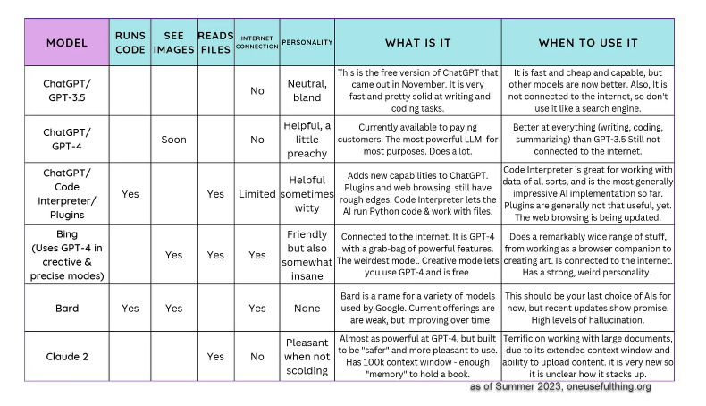
Comparison of LLMs by Ethan Mollick (Wharton School)
Best for writing
Best for working with data
Best for coming up with ideas, curating info
This Guide is focused on 3 LLMs - ChatGPT, Bing & Bard - in particular because they are the most used by students, are the most versatile across disciplines, and most familiar to the AI Office.
For more about using LLMs for computer programming, read Leo Porter’s (Associate Teaching Professor, CSE) new book.

Slide 11
Entry Point #1: GenAI & Learning
The box in green is where you’re headed next if you continue to progress through the slides. Otherwise, you can click on the next topic you want to explore.
What is Generative AI
What
GenAI can do
Why should I care about GenAI
Additional Readings
AI Tools you might want students to use
How do I test its impact on my class

Slide 12
What 3 particular
GenAI LLMs Can Do

Slide 13
Microsoft’s Bing Chat

Slide 14
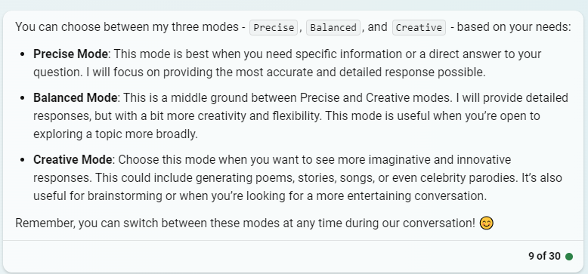
Bing Chat
Microsoft’s product built on OpenAI’s GPT-4
Generates content based on the input and its data (the internet in real-time)
Can provide internet sources
  But there often not the most legitimate sources
Has 3 modes: creative, balanced & precise
Can generate image responses and do image searching
Does NOT keep a history of chats
Allows for text or voice prompting

Slide 15
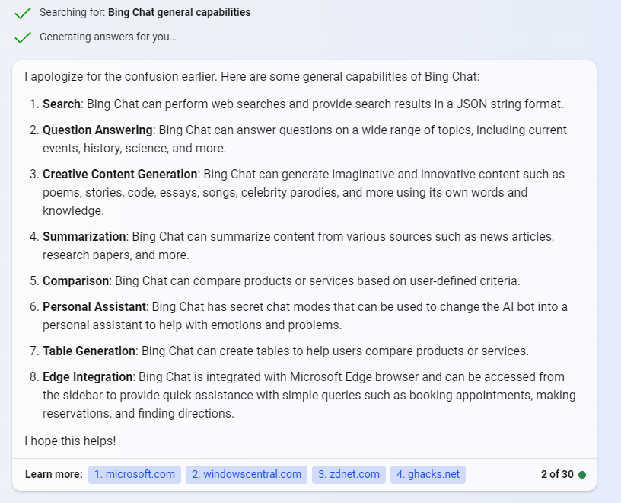
Bing Chat

Slide 16
Bing Chat
AIO Analysis
Bing Chat Creative Mode is fun for brainstorming or playing around with ideas and generating ideas
Bing Chat Precise & Balanced Modes are less, well, chatty. It is more difficult to get a lot of content out of it without asking question after question.
It seems to have a lot more parameters built in, prohibiting it from doing certain things (and less able to be “tricked” to operating outside those parameters)
Students are probably more likely to use it as a glorified search engine than as a way to cheat, at least on large, scaffolded assessments
Bing Chat would be very useful as a study tool, or, unfortunately, as a cheating tool for generating answers to online exam or homework questions
Want to know more? Interact with Bing Chat yourself or click here for an exchange with Bing asking what it can do, and explaining what it can’t do

Slide 17
Google’s Bard

Slide 18
Google Bard
Generates content based on the input and its data (the internet in real-time)
Can provide internet sources (sometimes, for simple things)
Doesn’t have a creative side, so doesn’t provide advice or talk about sensitive topics
Can generate output beyond text: image responses, coding, image search
Is compatible with a variety of plug-ins, making it very versatile
Keeps a history of chats
Can export content to google docs, google sheets, etc.
Allows for text or voice prompting
Source: https://www.educatorstechnology.com/2023/05/google-bard-vs-chatgpt-teachers-guide.html

Slide 19
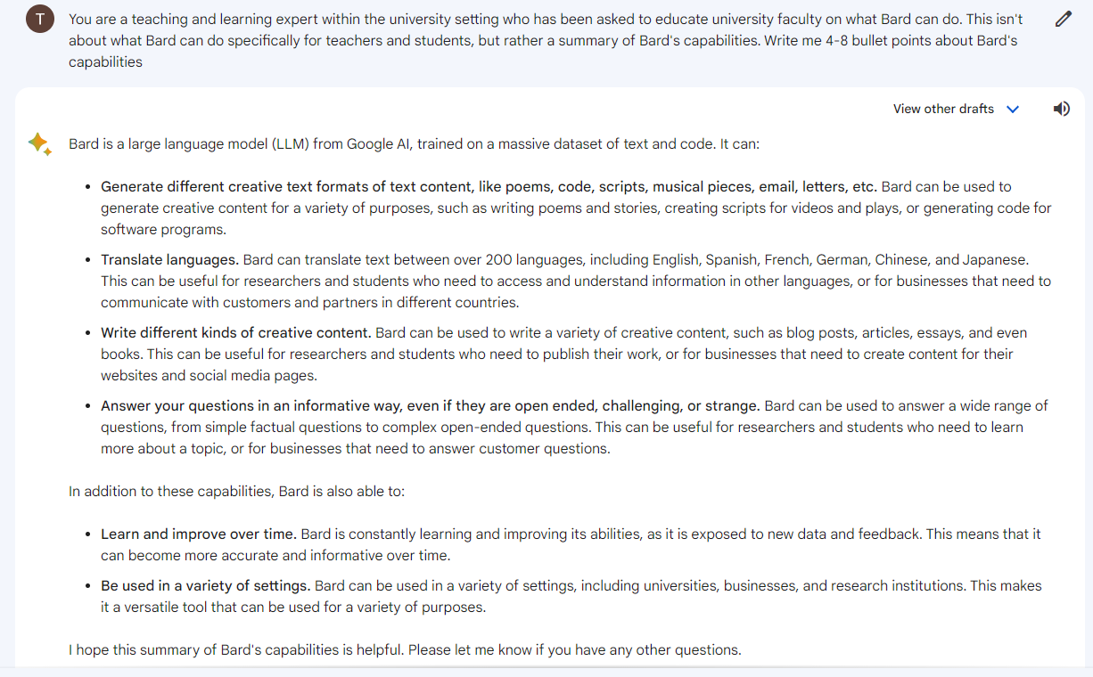

Slide 20
Google Bard
AIO Analysis
It’s less functional than Bing Chat for internet searching, doing research, and finding sources
But, it’s more likely to generate more output with less prompting than Bing requires.
Students are probably least likely to use Bard at this point as it seems to be the least developed
Bard would be somewhat useful as a study tool, or as a cheating tool for online exam or homework questions, but less helpful to generate essays or research papers.
Want to know more? Interact with Bard yourself or click here for an exchange with Bard asking what it can do, and explaining what it can’t do

Slide 21
OpenAI’s ChatGPT
-3.5 free version
-4 paid version

Slide 22
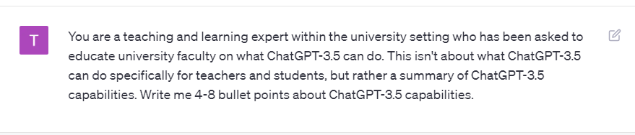
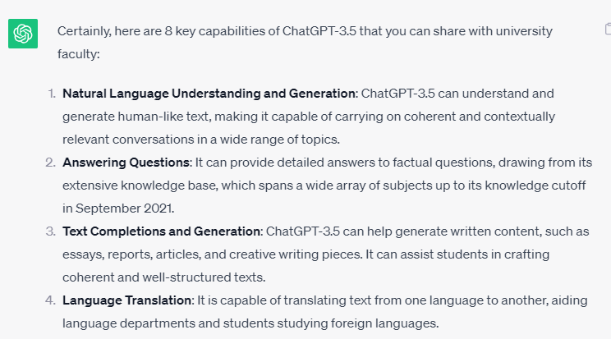
ChatGPT 3.5 (free)

Slide 23
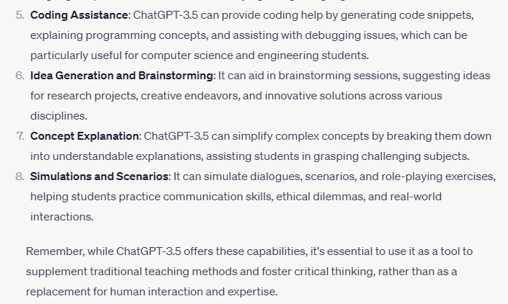
ChatGPT 3.5 (free)
ChatGPT-3.5’s Explanation of its capabilities continued

Slide 24
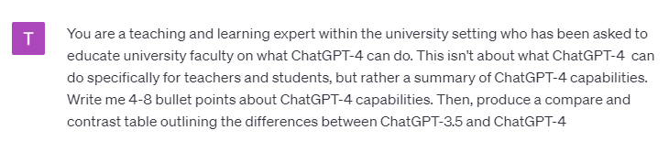
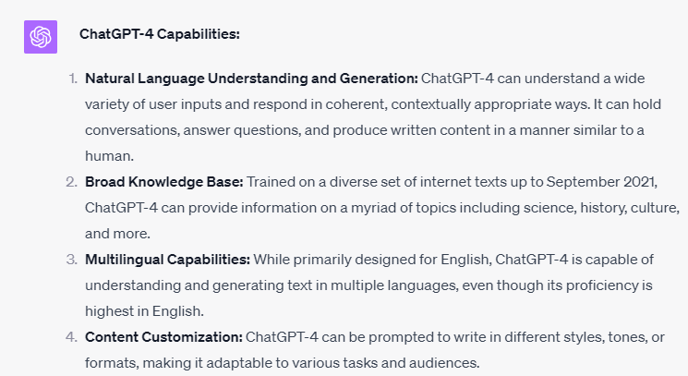
ChatGPT 4 (paid subscription)

Slide 25
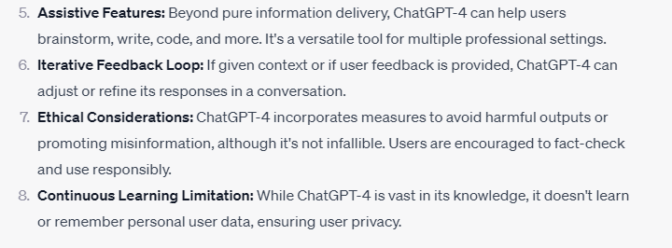
ChatGPT 4 (paid subscription)
ChatGPT-4’s Explanation of its capabilities continued

Slide 26
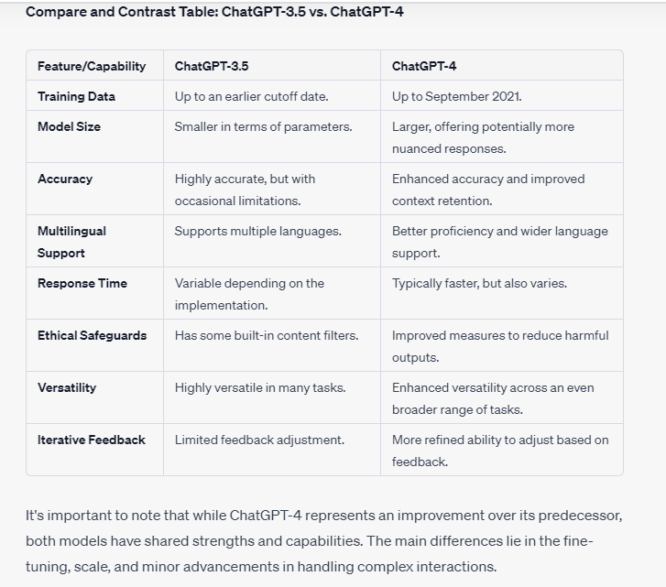
ChatGPT 4 (paid subscription)
ChatGPT-4’s Explanation of its capabilities continued

Slide 27
ChatGPT-3.5 & 4
AIO Analysis
Both are highly functional and very helpful for generating a lot of content fast across many disciplines
  Computer science, languages, arts and humanities, social sciences, physical sciences, business, etc.
There are limitations of the training data set (up to 2021)
  but plugins can get GPT-4 connected to the internet
Students are probably most likely to use ChatGPT because it has received the most exposure in the media/social media
  And more likely to use GPT-3.5 since its free
  keep in mind that students may also use GenAI tools built into their existing favorite tools like SnapGPT
We find ChatGPT-4 to be the most useful as a cheating tool as it will generate answers to anything and everything (even if sometimes it’s wrong)
  It can now also provide real citations with hyperlinks to publications from 2021 or earlier
Keeps a history of chats (unless the user opts not to), which you will see in the Policy section that this can be helpful.
Want to know more? Interact with ChatGPT yourself or click here for an exchange with ChatGPT-4 asking what it can do, and explaining what it can’t do. Need help getting started?

Slide 28
And there are many more GenAI Tools that exist
Claude.ai - a chatbot similar to ChatGPT, Bing & Bard
Consensus.app - answer any question about anything!
Wolfram Alpha - an oldie but a goodie - provides answers in Math, Science, Society, etc.
MathGPTPro - solving advanced mathematics questions
Humata AI - an LLM that can summarize and synthesize articles, and answer questions about those articles (as well as generate new content)
Orygo AI - reads and generates explanations of research so you don’t have to!
PaperBrain - interface between “reader” and reading - ask the AI what the paper/reading is about - the AI of cliff/sparks notes
For a comprehensive and constantly updated inventory of AI tools, check out Futurepedia

Slide 29
Entry Point #1: GenAI & Learning
The box in green is where you’re headed next if you continue to progress through the slides. Otherwise, you can click on the next topic you want to explore.
What is Generative AI
What
GenAI can do
Why should I care about GenAI
Additional Readings
AI Tools you might want students to use
How do I test its impact on my class

Slide 30
Why Should I Care about the impact of these GenAI tools on my class learning outcomes?

Slide 31
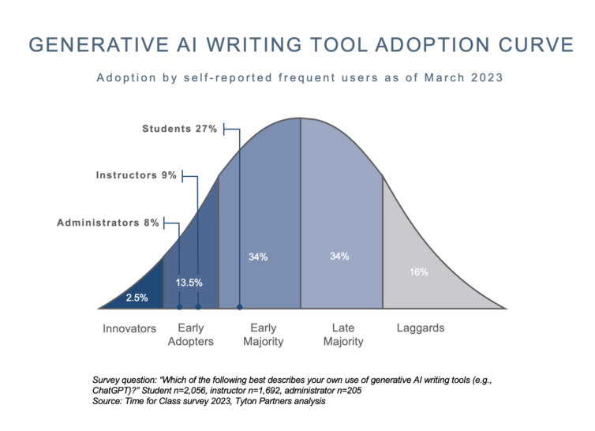
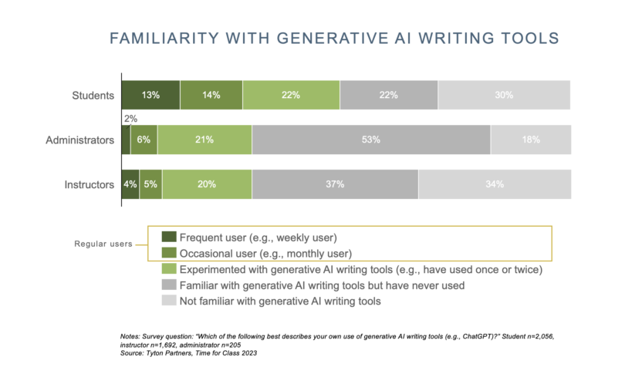
Students are using it and they are using it more than you are!

Slide 32
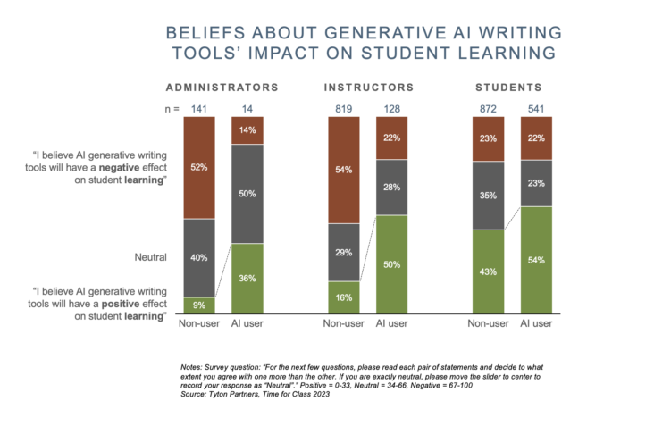
Students are using the tools because they believe that they will be helpful and have a positive impact on their learning

Slide 33
Ignoring the impact of GenAI Tools on your Course Learning Outcomes undermines:
teaching
  you’re not teaching the skills/knowledge you think you are
learning
  the students aren’t learning what we intended
assessment integrity
  we aren’t evaluating what we think we are
degree integrity
  Students don’t have the knowledge & skills we say they do

Slide 34
Entry Point #1: GenAI & Learning
The box in green is where you’re headed next if you continue to progress through the slides. Otherwise, you can click on the next topic you want to explore.
What is Generative AI
What
GenAI can do
Why should I care about GenAI
Additional Readings
AI Tools you might want students to use
How do I test its impact on my class

Slide 35
How do I figure out how it will impact my course learning outcomes?

Slide 36
Try it out!
Two choices (depending on your comfort level):
Use some pre-existing prompts from others
OR
Copy and paste your own course learning outcomes (or an assessment prompt designed to measure the learning outcome) into one of the tools
* The second is more helpful, but some instructors are worried about: 1) helping to train the tools with their intellectual property; 2) unanswered copyright questions with GenAI. Having said that, your students likely have already or will be pasting your prompts into GenAI anyway. Regardless, you can opt out of OpenAI retaining and using your input.

Slide 37
Testing Course Learning Outcomes
On successful completion of this course, students will be able to:
Knowledge | ChatGPT-3.5 Success
outline significant curriculum and assessment theories, models and research in the higher-education sector. | https://chat.openai.com/share/ed426f8a-63e2-4651-8c14-113dcf2909da
critically analyse disparate sources of information about WWII. | https://chat.openai.com/share/e7b76145-cbed-4603-b53a-3a829953444e
evaluate concepts of race, culture, identity and diversity with regards to indigenous education. | https://chat.openai.com/share/b0d7bf2a-902c-4caf-b78b-fdaa9325c526
Conclusion: ChatGPT-3.5 is very useful for faking achievement of KNOWLEDGE level learning outcomes, even if only at the C level (but Cs get degrees!)
The above course learning outcomes were copied from this website

Slide 38
Testing Course Learning Outcomes
On successful completion of this course, students will be able to:
Skills | ChatGPT-3.5 Success
plan and develop an independent research project that uses research methodologies that are appropriate to the discipline. | ChatGPT can do some of the lifting of planning and developing, so perhaps planning & developing should not be the ultimate outcomes; instead, raise this outcome to “implementing and communicating orally about the project” (while allowing GenAI use to help plan and develop)
communicate through oral presentations using visual, verbal and written information. | Obviously, ChatGPT cannot communicate orally, but students could use ChatGPT to generate the content, other GenAI tools to create the slidedeck, and, if the presentation is over zoom or recorded, still other GenAI tools to make it appear as if they (rather than AI) are giving the presentation
apply technical skills in creating and formatting digital media content, including 2D animation. | GenAI tools are really good and creating and formatting digital media content, including 2D animation, so updating this learning outcome for GenAI era might mean that the instructor has to evaluate process (the student doing the work) rather than only the final product
The above course learning outcomes were copied from this website

Slide 39
Testing Course Learning Outcomes
On successful completion of this course, students will be able to:
Application of knowledge and skills | ChatGPT-3.5 Success
analyse electrical engineering problems in industrial settings. | ChatGPT can achieve this generic learning outcome, generically. This is another example of a learning outcome might be okay, as long as there is an assessment of this process in action, rather than an assessment of it through product
demonstrate critical reflection on their professional knowledge and skills, incorporating broad subject knowledge and perspectives. | This would be hard for a GenAI tool to do, basically because the learning outcome isn’t sufficiently specific (i.e., it’s not a good GenAI prompt!). Whether students could use a GenAI tool to help them along the way to achieve this outcome, depends on the assessments
communicate architectural and built-environment ideas through the medium of film. | GenAI tools might do some lifting of this for students, see ChatGPT-3.5 and Bard, but ultimately, at this point in time, much of this learning outcome would need to be accomplished by a human
The above course learning outcomes were copied from this website

Slide 40
Testing Course Learning Outcomes: Conclusion
The higher the learning outcomes are on Bloom’s Taxonomy, the less useful GenAI tools are for undermining them
The method of assessment of the learning outcome will also determine how useful GenAI is for undermining the intended learning (i.e., cheating)
Analyzing your own course learning outcomes might help you decide if, when and under which conditions might a student use GenAI to actually help them achieve the learning outcome (i.e. allow them to cognitively offload lower level tasks necessary to achieve higher level learning)

Slide 41
Entry Point #1: GenAI & Learning
The box in green is where you’re headed next if you continue to progress through the slides. Otherwise, you can click on the next topic you want to explore.
What is Generative AI
What
GenAI can do
Why should I care about GenAI
Additional Readings
AI Tools you might want students to use
How do I test its impact on my class

Slide 42
GenAI Tools You Might Want Students to Use
(to help them achieve the learning outcomes)

Slide 43
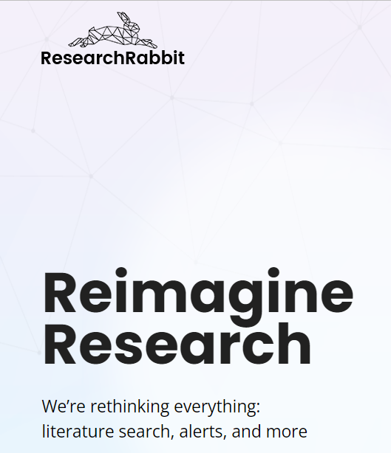
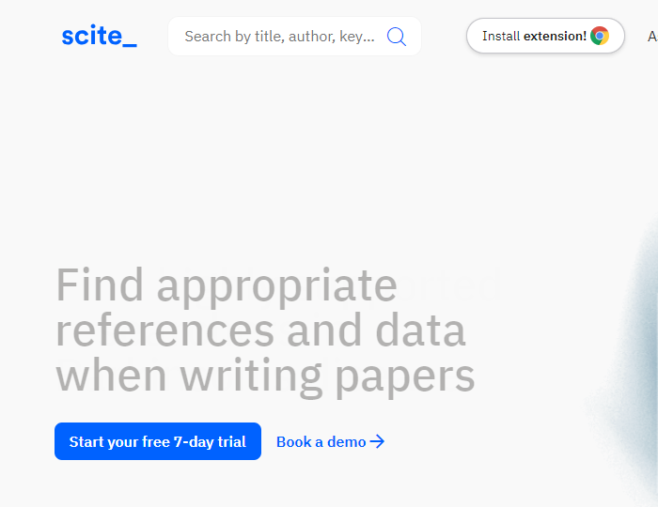
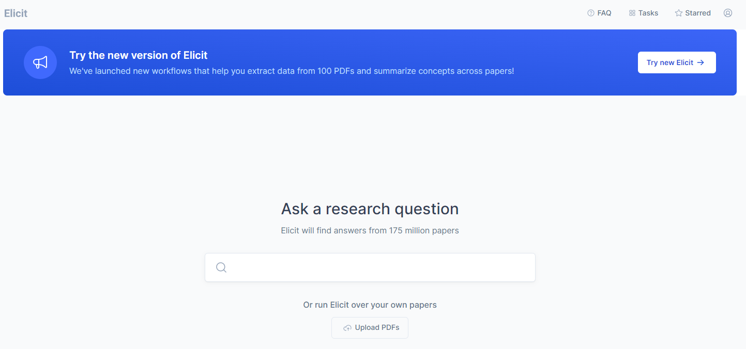
GenAI Tools you might want students to use: for Research

Slide 44
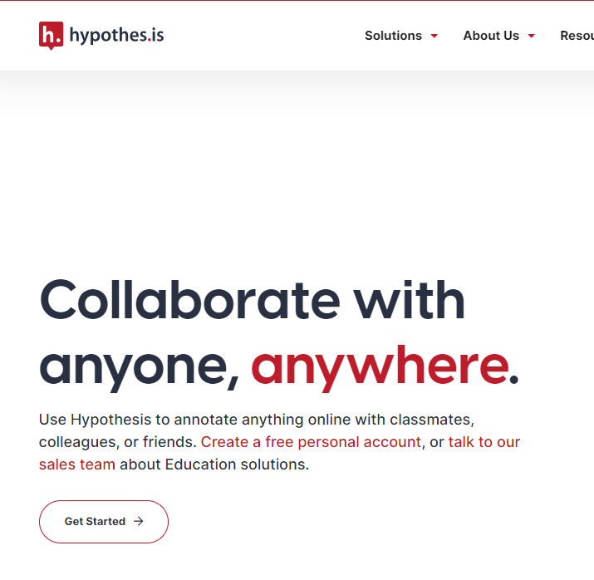
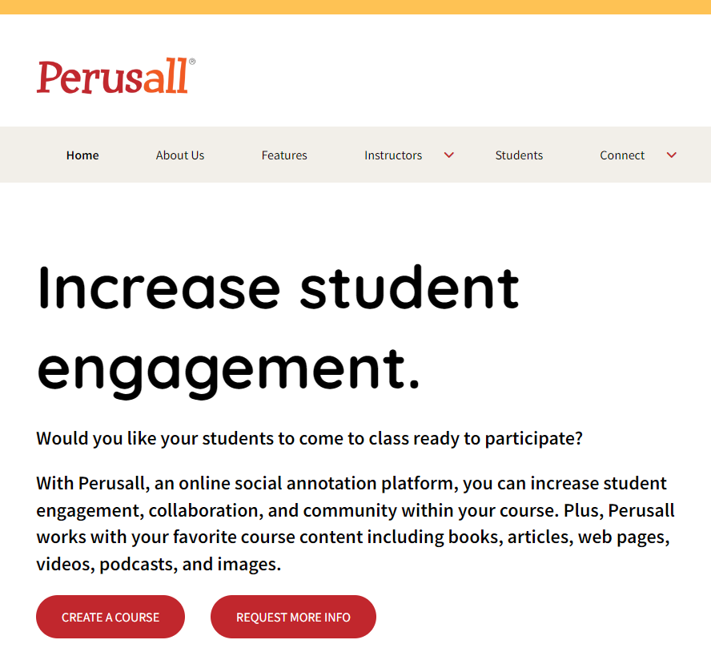
GenAI Tools you might want students to use: for Transparency (Annotation)

Slide 45
Entry Point #1: GenAI & Learning
The box in green is where you’re headed next if you continue to progress through the slides. Otherwise, you can click on the next topic you want to explore.
What is Generative AI
What
GenAI can do
Why should I care about GenAI
Additional Readings
AI Tools you might want students to use
How do I test its impact on my class
Next Step

Slide 46
Additional Readings
More Food for Thought
ChatGPT in Higher Education: Artificial Intelligence and its Pedagogical Value
Three Things to Know about AI Tools and Teaching
I’m a Student. You have no Idea How Much We’re Using ChatGPT
Professors Craft Courses on ChatGPT with ChatGPT
ChatGPT and large language model bias
ChatGPT: Bullshit Spewer or the End of Traditional Assessments in Higher Education?
Exploring the Potential of Generative Artificial Intelligence in Education: Applications, Challenges, and Future Research Directions
Why ChatGPT & Bing are so Good at Making Things Up
The Difference between Generative AI and Traditional AI: An Easy Explanation for Anyone
Fun With GenAI
Did a Fourth Grader Write this? Or ChatGPT? (You can play the game!)
South Park’s Deep Learning Episode (cautionary note: it’s SouthPark so some may find it offensive)
A GPT-4 Capability Forecasting Challenge
Practical Resources
A Wired Comparison of ChatGPT, Bing & Bard
An AVID Open Access Comparison of ChatGPT, Bing & Bard
Learn More About Artificial Intelligence
Learn More About ChatGPT-4
ChatGPT in Higher Education (a brief book)
Generative AI is Only as Good as the Prompt You Give It
The Art of ChatGPT Prompting
GenAI Chatbot Prompt Library for Educators
Generative AI Prompt Literacy from University of Michigan-Flint
AI Prompts for Teaching

Slide 47
Next entry point
Will GenAI use undermine the course learning outcomes?
Can the learning outcomes be revised?
Revise the learning outcomes
YES
YES
NO
NO
Can the assessments be redesigned?
Redesign the assessment(s)
YES
NO
Will GenAI use undermine assessment validity?
Secure the Assessment(s)
YES
Allow GenAI Use
Craft Your GenAI & AI Policy
NO

Slide 48
Entry Point #2
Revising Learning Outcomes

Slide 49
Entry Point #2: Revising Learning Outcomes
Learning Outcomes: 101
Why should I revise Learning Outcomes
Choose where to start by clicking on the box you want to explore.You can progress through the slides in order as well. The green topic box is the next topic.
Additional Readings
How do I revise?

Slide 50
Learning Outcomes 101

Slide 51
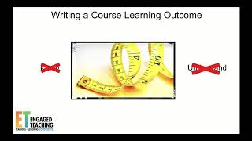
Watch this Video by Paul Hadjipieris, UC San Diego Learning Development Specialist, to learn what Learning Outcomes are, why they are important, and how you can write them

Slide 52
Video (Slide 31) Referenced Resource: Bloom’s Taxonomy
Bloom’s Taxonomy (1956; Anderson & Krathwohl, 2001) classifies thinking into six levels of increasing complexity (lower order thinking skills to higher order thinking skills). It is a useful resource when determining the level of our educational goals and what evidence we are looking for in how our students’ demonstrate achievement of those goals. Depending on where a course falls within a curriculum, course level learning outcomes will likely target multiple levels of thinking described in Bloom’s Taxonomy. Since Program Learning Outcomes (PLOs) reflect what we want students to know, be able to do, and what we want them to value at the completion of their program, PLOs will likely target higher order thinking.
create
Produce new or original work
adapt, arrange, collect, compose, create, design, develop, formulate, invent, plan, produce, rearrange, reconstruct, write
Learning Outcomes at the Apply or higher level are harder for GenAI tools to achieve
evaluate
Justify a stand or decision
appraise, argue, assess, conclude, convince, critique, deduce, defend, evaluate, hypothesize, judge, justify, recommend
analyze
Draw connections among ideas
analyze, calculate, compare, contrast, differentiate, distinguish, explain, illustrate, manipulate, modify, predict
Cognitive process
apply
Use information in new situations
apply, chart, construct, demonstrate, illustrate, modify, produce, show, sketch, solve, write
understand
Explain ideas or concepts
classify, demonstrate, describe, explain, express, interpret, organize, paraphrase, summarize
remember
Recall facts and basic concepts
define, identify, label, list, locate, match, name, recognize, select, state
Notes:
The six cognitive processes of Bloom’s Taxonomy (remember, understand, apply, analyze, evaluate, create).

Slide 53
Before you Jump to Reviewing & Revising
L. Dee Fink says that you should consider the Situational Factors of your course, which include the:
specific class context
  How many students are in the class?
  Is the course at the lower division, upper division, or graduate level?
  How long and frequent are the class meetings?
  Will the course be delivered live, online, in a laboratory, etc.?
  What physical elements of the learning environment will affect the class?
university context
  What learning expectations are placed on this course by the university, the college, one or more of the institution’s curricula, one or more professions, and society in general?
nature of the subject.
  Is this subject primarily theoretical, practical, or a combination?
  Is it primarily convergent or divergent?
  Are there important controversies or recent changes within the field?
learner characteristics
  What are the life situations of the learners (what percent work, have family responsibilities, have a specific professional goal, etc)?
  What prior knowledge and experiences relevant to this subject have students had?
  What are their goals and expectations of the course?
instructor characteristics
  What beliefs and values do you have about teaching and learning?
  What level of knowledge do you have about the subject?
  What are your teaching strengths and weaknesses?

Slide 54
Situational Factors….
“impose definite limitations and guidelines on those seeking to design a significant learning experience. For example, if the course is intended to provide background for more advanced courses, it is essential to understand the expectations of those teaching such courses. Similarly, if most students begin the class with an apathetic attitude toward the subject matter, the course design needs to recognize this and incorporate special motivational features. Once situational factors have been identified and considered, the instructor is prepared for the next step in the design process, namely the establishment of learning goals.”
L. Dee Fink, Integrated Course Design

Slide 55
Entry Point #2: Revising Learning Outcomes
Learning Outcomes: 101
Why should I revise Learning Outcomes
The box in green is where you’re headed next if you continue to progress through the slides. Otherwise, you can click on the next topic you want to explore.
Additional Readings
How do I revise?

Slide 56
Why should I review and possibly revise learning outcomes for the GenAI era?

Slide 57
Reasons to Revise Learning Outcomes for the GenAI Era
Reason #1: Course Learning Outcomes should regularly be reviewed (and possibly revised) regardless of GenAI
“Assessment is an iterative process and it is good practice to revisit your learning outcome statements regularly – particularly as you change the way the course is being taught and/or the content of your course (Wiggins & McTighe, 2005).”

Slide 58
Reasons to Revise Learning Outcomes for the GenAI Era
Reason #2: GenAI can quickly and easy complete low-level or generic learning outcomes
See next slide for examples of how ChatGPT-4 generated responses to 6 learning outcomes.

Slide 59

ChatGPT-4 Responses to 6 Learning Outcomes
Bloom’s Level | Example | ChatGPT-4 Responses
Create | Develop and defend a policy brief informed by existing political phenomena. | https://chat.openai.com/share/2257106e-5d88-47e4-8b48-a74a42cb99cb
Evaluate | Assess an existing political institution and recommend evidence-based modifications to improve democratic governance. | https://chat.openai.com/share/a1b57b6b-3207-42d4-b221-b141b0ad297c
Analyze | Compare and contrast different forms of government and the significant historical figures represented with each regime. | https://chat.openai.com/share/669ca5b4-a0bc-432b-8cad-5ce7b7a1a284
Apply | Write an argument supporting a political party platform and integrate relevant evidence from the texts. | https://chat.openai.com/share/d64b6463-e705-477e-b79a-101f6255c33a
Understand | Explain contrasting political theories from different vantage points. | https://chat.openai.com/share/7382c51d-4eee-47d3-b720-3c4346d4af36
Remember | Define relevant vocabulary for international affairs discourse. | https://chat.openai.com/share/28392fdf-bb7f-4373-95f1-dddbb4404787
Adapted from the following:
1. Bloom’s Taxonomy, Vanderbilt Center for Teaching. https://cft.vanderbilt.edu/guides-sub-pages/blooms-taxonomy/
2. Bloom’s Verbs, UC San Diego Teaching + Learning Commons https://digitallearning.ucsd.edu/_files/blooms_verbs.pdf
3. Bloom’s Taxonomy, Course Map Guide. https://www.coursemapguide.com/bloom-s-taxonomy
4. Undergraduate Program Learning Outcomes, Department of Political Science, UC San Diego.

Slide 60
Reasons to Revise Learning Outcomes for the GenAI Era
Reason #3: Maybe students can (and should) cognitively offload some tasks to GenAI
For example, learning outcomes related to spelling, grammar, and reference formatting used to be quite common. They have largely been eliminated because students now cognitively offload those tasks to machines.
Question for you:
Are you still trying to assess learning that students no longer need to do in your course?
If yes, you could replace those learning objectives with others.

Slide 61
Reasons to Revise Learning Outcomes for the GenAI Era
Reason #3 (cont’d): Maybe students can (and should) cognitively offload some tasks to GenAI
For example, sometimes courses are assessing learning that is tangential to the purpose of the course, like writing in a non-writing focused course, or math in a non-math course, or statistical analysis in a research-writing course.
Questions to consider:
What is the purpose of your course?
Are all of your learning outcomes directly related to that purpose?
If not, could you remove those indirectly or unrelated learning outcomes?

Slide 62
Reasons to Revise Learning Outcomes for the GenAI Era
Reason #4: learning how to use A.I. critically and ethically may need to be taught in relation to your discipline
Should you think about adding in any learning outcomes that focus on the use of Generative A.I. tools given the trajectory of your discipline?
For example: “students will critically analyze ChatGPT output pertaining to [some disciplinary concept] for bias, accuracy, evidence, misinformation, and logic.”

Slide 63
Entry Point #2: Revising Learning Outcomes
Learning Outcomes: 101
Why should I revise Learning Outcomes
The box in green is where you’re headed next if you continue to progress through the slides. Otherwise, you can click on the next topic you want to explore.
Additional Readings
How do I review & revise?

Slide 64
How to Review & Revise Learning Outcomes

Slide 65
How to Revise Course Learning Outcomes
Idea #1 Replace those that are no longer necessary
Are there outcomes that are no longer necessary to assess because they are not foundational knowledge (needed for higher order thinking) and can be offloaded to machines?
Idea #2 Tweak others to:
  move them up Bloom’s Taxonomy of Learning
    see next slide for an example
  Make them more meaningful/authentic
    Have students apply them to real-life and contemporary situations
  Build in learning accountability
    Require a public demonstration of the achievement of the learning outcome (this gets us more into assessment redesign, but important to think of it at this stage as well)

Slide 66
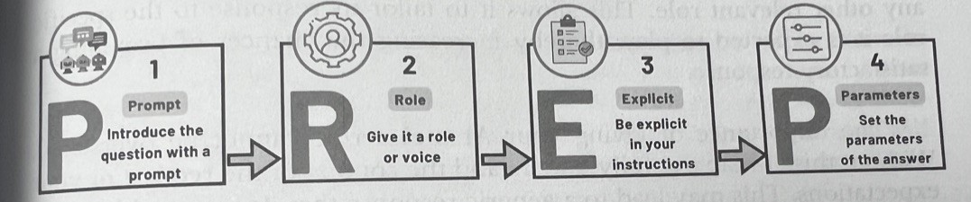
How to Revise Course Learning Outcomes
How to use ChatGPT to Revise your Learning Outcomes
P = You are going to rewrite the following learning outcome (paste the learning outcome into the chatbot)
R = give it your role (i.e., “you are a professor of X skilled at writing and revising learning outcomes. You want to update your learning outcomes to make it less likely that students will outsource their learning to GenAI tools.”)
E = tell it explicitly what you do or don’t want it to do (e.g., do keep it focused on the same content)
P = tell the chatbot the grade level (e.g., entry level university course vs senior university course), the size of the class, the composition of the class (e.g., majors only, majors and non-majors), and other course information (e.g., required or not required; EDI course or not)

Slide 67
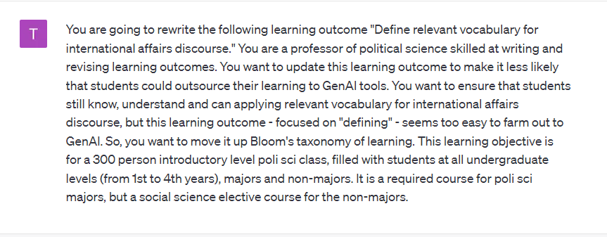
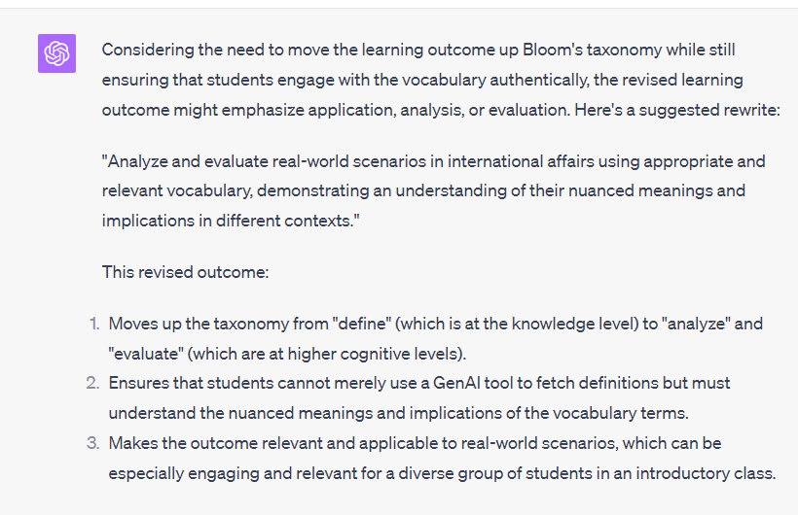
Prompt to ask ChatGPT-4 to Rewrite a Learning Outcome
ChatGPT-4’s Output

Slide 68
Entry Point #2: Revising Learning Outcomes
Learning Outcomes: 101
Why should I revise Learning Outcomes
The box in green is where you’re headed next if you continue to progress through the slides. Otherwise, you can click on the next topic you want to explore.
Additional Readings
How do I review & revise?
Next Step

Slide 69
Additional Readings
A Taxonomy for Learning, Teaching & Assessing: A Revision of Bloom’s Taxonomy of Educational Objectives
Opinion Pieces
GPT-4 Can Already Pass Freshman Year at Harvard: Professors Need to Adapt to their Students’ New Reality-FAST
Bloom and Grow - teaching in the era of ChatGPT
How Can Generative AI intersect with Bloom’s Taxonomy
Practical Application
Yale’s Writing Intended Learning Outcomes with Bloom’s Taxonomy
University of Wisconsin-Madison’s Writing Student Learning Outcomes
Want step-by-step help rewriting your Learning Outcomes?
Check out this Learning Outcome Generator from Indiana University

Slide 70
Will GenAI use undermine the course learning outcomes?
Can the learning outcomes be revised?
Revise the learning outcomes
YES
YES
Next entry point
NO
NO
Can the assessments be redesigned?
Redesign the assessment(s)
YES
NO
Will GenAI use undermine assessment validity?
Secure the Assessment(s)
YES
Allow GenAI Use
Craft Your GenAI & AI Policy
NO

Slide 71
Entry Point #3
Redesigning Assessments
In the Era of GenAI

Slide 72
Entry Point #3: Redesigning Assessments
Choose where to start by clicking on the box you want to explore.You can progress through the slides in order as well. The green topic box is the next topic.
What are Assessments
Why Rethink Assessments
How to Redesign Assessments
Additional Readings
Practical Ideas for Updating Assessments

Slide 73
What are Assessments?

Slide 74
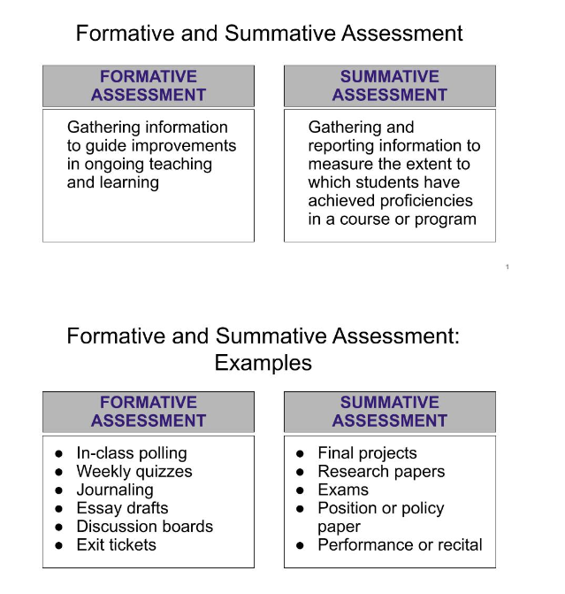

What are Assessments?
Assessments are activities we have students do for one of two reasons:¹:
  to facilitate learning by providing frequent feedback (formative)
  to evaluate the learning that has occurred (summative)

Slide 75
Formative Assessments
Those given to facilitate the students learning or acquisition of skills and knowledge
the main goal is to provide students with practice, experience, and feedback in order to improve their learning
If grades are given at all for formative assessments, they should only be minimal and given for completion or submission, not for accuracy
For example:
  practice problems
  homeworks
  drafts of a summative assessment
  lab work
  peer reviews
  discussion board posts

Slide 76
Summative Assessments
evaluate if the student has achieved a learning objective and to what extent
need to be valid measures of student learning because these assessments determine if:
  A student is ready to move on to the next course in the sequence
  A student has earned a certification of their knowledge and abilities (i.e., a degree)
For example:
    Tests
    Research papers
    Take-home exams
    Essays
    Projects

Slide 77
All assessments should be clearly tied to the learning outcomes

Slide 78
Example Assessments for the Learning Objectives previously seen on Slide 35
Bloom’s Level | Example | Assessments
Create | Develop and defend a policy brief informed by existing political phenomena. | Policy proposal, structured debate, research project, oral examination
Evaluate | Assess an existing political institution and recommend evidence-based modifications to improve democratic governance. | Case study, journal article or book critique, learning journal, peer review, video or audio recording
Analyze | Compare and contrast different forms of government and the significant historical figures represented with each regime. | Literature review, concept map, debate, case study, research paper, discussion forums
Apply | Write an argument supporting a political party platform and integrate relevant evidence from the texts. | Essay, presentation, scenario response, short answer response
Understand | Explain contrasting political theories from different vantage points. | Discussions, reading summaries, identifying political theories, concept map, true or false quiz questions, group discussion
Remember | Define relevant vocabulary for international affairs discourse. | Multiple choice, fill in blank, recite, word/definition match, polling questions
Adapted from the following:
1. Bloom’s Taxonomy, Vanderbilt Center for Teaching. https://cft.vanderbilt.edu/guides-sub-pages/blooms-taxonomy/
2. Bloom’s Verbs, UC San Diego Teaching + Learning Commons https://digitallearning.ucsd.edu/_files/blooms_verbs.pdf
3. Bloom’s Taxonomy, Course Map Guide. https://www.coursemapguide.com/bloom-s-taxonomy
4. Undergraduate Program Learning Outcomes, Department of Political Science, UC San Diego.

Slide 79
Entry Point #3: Redesigning Assessments
The box in green is where you’re headed next if you continue to progress through the slides. Otherwise, you can click on the next topic you want to explore.
What are Assessments
Why Rethink Assessments
How to Redesign Assessments
Additional Readings
Practical Ideas for Updating Assessments

Slide 80
Why Rethink Assessments in the GenAI era?

Slide 81
Why Rethink Assessments in the GenAI Era?
Reason #1: To maintain assessment validity, the only other options are Banning GenAI or Securing every assessment
  Banning won’t work (students will use it anyway) and violations of the ban won’t be easily detected
    Most AI Detectors do NOT work
      they are often wrong
      may be biased with non-native English writing
      are easily thwarted
      see this research study
  Securing every assessment (i.e., having students complete them in a proctored setting) may:
    disproportionately disadvantage students with disabilities
    take a lot of resources (and class time)
    not be the right choice for assessing all learning outcomes

Slide 82
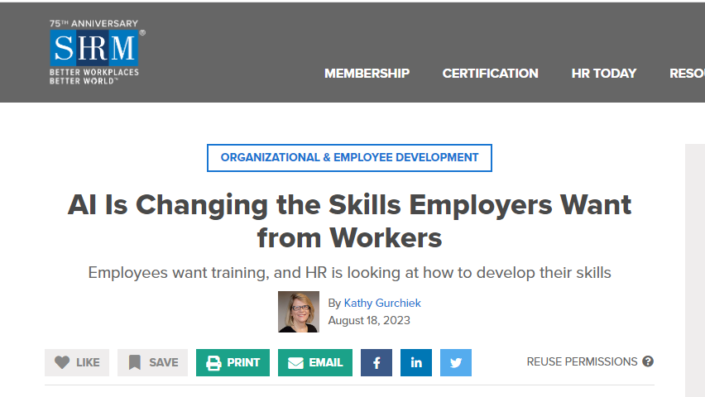
Why Rethink Assessments in the GenAI Era?
Reason #2: Our graduates may be expected to be able to work with, not without, GenAI tools
Incorporating GenAI tools into assessments may better equip our students for life after graduation

Slide 83
Why Rethink Assessments
Reason #3: Necessary to maintain student engagement in the learning process
Assessments need to be rethought from time to time due to advances in technology, changes in the student population, or evolution of knowledge
Students will cognitively offload their academic work (and therefore not learn what was intended) if the assessment seems “out-of-date” and easy to complete with GenAI
  Partly because they see cognitively offloading often allowed during assessments
      Using an authorized notes sheet during a test
      Using a calculator on a math-based test
      Using spelling/grammar check in a paper
      Using RefWorks to create a formatted list of references
      Working with a partner
Authentic assessments are more likely to keep students focused on learning (rather than cheating)

Slide 84
Pre-GenAI Example of Cognitive Offloading
GenAI Example of Cognitive Offloading
A Math professor assigns homework from the practice problems at the end of a textbook chapter.
The students copy from the textbook solutions and submit those copies for academic credit.
The professor grades those submissions.
The grades represent the students’ ability to copy and paste, not the students’ knowledge and abilities in MATH.
The assessment has no (limited?) validity.
A Psychology professor assigns an annotated bibliography
The students use ChatPDF to summarize the articles, runs those summaries through Quillbot, and then copies and pastes the summaries into their annotated bibliography document
The professor grades the Annotated Bibliographies
The grades represent the students’ ability to use GenAI, not the students’ abilities to critically read and summarize research articles
The assessment has no (limited?) validity.

Slide 85
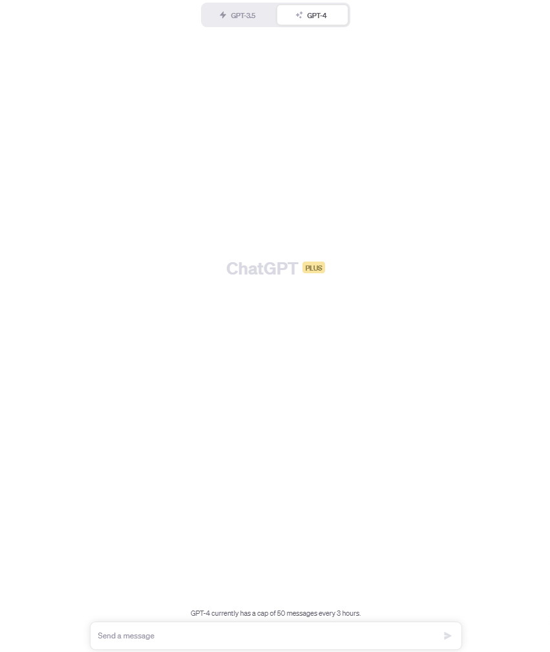
Example of Easy Cognitive
Offloading to GenAI
Describe and analyze the processes by which a distinctively American identity was created and changed over time. What historical forces and events helped to forge this identity? In what specific ways has this identity been contested? Has this identity been broad and inclusive, or has it tended to create un-American or non-American “Others?”
^{Prompt found here}

Slide 86
Heuristic for Determining if You Should Rethink Your Assessments
Is it an out-of-class assessment?
Is it written?
Does it require only lower-order skills?
Is the answer easily/readily generated and/or copied/pasted from online?
Is your assessment recycled from other quarters/classes?
Do you have the time and knowledge to rethink?
If yes to one or more of the above, need to rethink!
https://lx.uts.edu.au/collections/artificial-intelligence-in-learning-and-teaching/resources/ai-resilience-diagnostic-for-assessment-tasks/

Slide 87
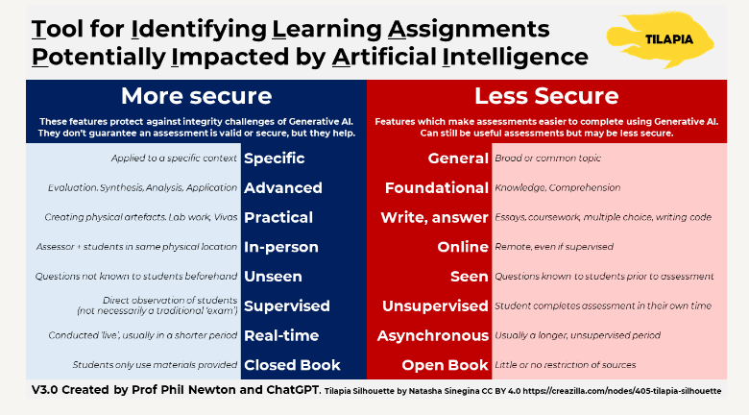
Another Heuristic: Phil Newton’s Tool for Determining if you should rethink your assessments
Phil explains this tool starting at 4:55 time in this video

Slide 88
Entry Point #3: Redesigning Assessments
The box in green is where you’re headed next if you continue to progress through the slides. Otherwise, you can click on the next topic you want to explore.
What are Assessments
Why Rethink Assessments
How to Redesign Assessments
Additional Readings
Practical Ideas for Updating Assessments

Slide 89
How to Redesign Assessments in the GenAI era

Slide 90
Guiding Questions for Revising Assessments
(adapted from Derek Bruff)
Why does this assessment make sense for this course?
What are specific learning outcomes for this assessment?
How might students use AI tools while working on this assessment?
How might AI undercut the goals of this assessment? How could you mitigate this?
How might AI enhance the assessment?
Is there anything students can use GenAI to do for your class?
    Invention/brainstorming (solving the “blank page” syndrome)
    Outlining
    Revision
    Research
Do the learning objectives support you using GenAI output as the starting point?
Can you intentionally infuse A.I. into an activity or assessment?
Can you build in a greater focus on the process (rather than product)?
Can you make the assessment more meaningful for students?
For a walk-through of how to apply some of these questions to an actual assignment, click here.

Slide 91
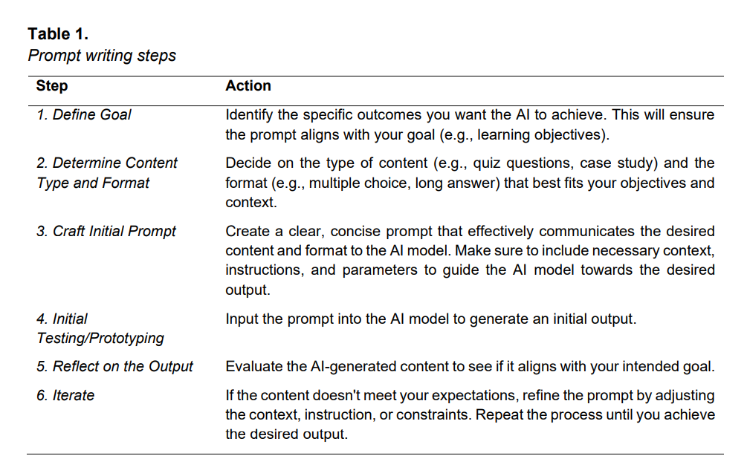
How to use GenAI to Redesign Assessments
https://ro.uow.edu.au/cgi/viewcontent.cgi?article=3299&context=jutlp

Slide 92
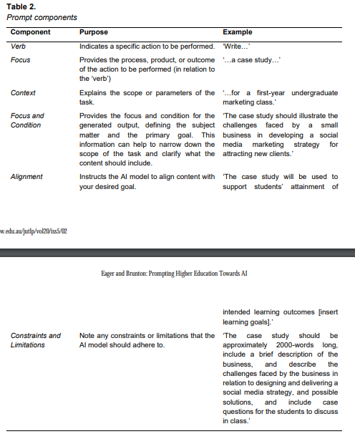
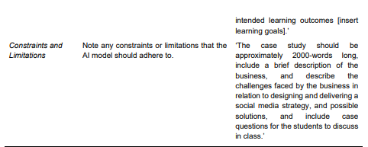
How to use GenAI to Redesign Assessments
https://ro.uow.edu.au/cgi/viewcontent.cgi?article=3299&context=jutlp

Slide 93
To learn how to use GenAI in your teaching role, see Prompting Higher Education Towards AI-Augmented Teaching and Learning Practice
The article covers how to use GenAI to:
Align Prompts with Learning Goals and Assessment Criteria
Encourage Critical Thinking and Problem-Solving Skills
Foster Student Engagement and Interaction
Ensure Prompts are Adaptable Across Learning Contexts
Design assessments with AI-generated content
Create Learning Experiences for Diverse Student Needs

Slide 94
Entry Point #3: Redesigning Assessments
The box in green is where you’re headed next if you continue to progress through the slides. Otherwise, you can click on the next topic you want to explore.
What are Assessments
Why Rethink Assessments
How to Redesign Assessments
Additional Readings
Practical Ideas for Updating Assessments

Slide 95
Practical Ideas to Update Assessments

Slide 96
#1: Update the Assessment Prompt
(aka the assignment question)
To make it less effective to offload work to GenAI
  Move it up higher on Bloom’s Taxonomy
    See next slide
  Require connections to in-class conversations/discussions
    To effectively use GenAI for such assessments, the student would have to provide those conversations/discussions to the tool; not impossible, but it takes effort and so offloading to the tool may not seem as attractive
  Require use of course-assigned resources
    Same as above
    Also, GenAI tool may not have access to those resources unless the student provides them
      And even if the tool does, GenAI can’t read! So, the output will be generic, off-topic, or factually incorrect
To make it more meaningful and personally relevant to the students
  This will enhance intrinsic motivations, which reduces the likelihood that students will want to cognitively offload their assessment to GenAI

Slide 97
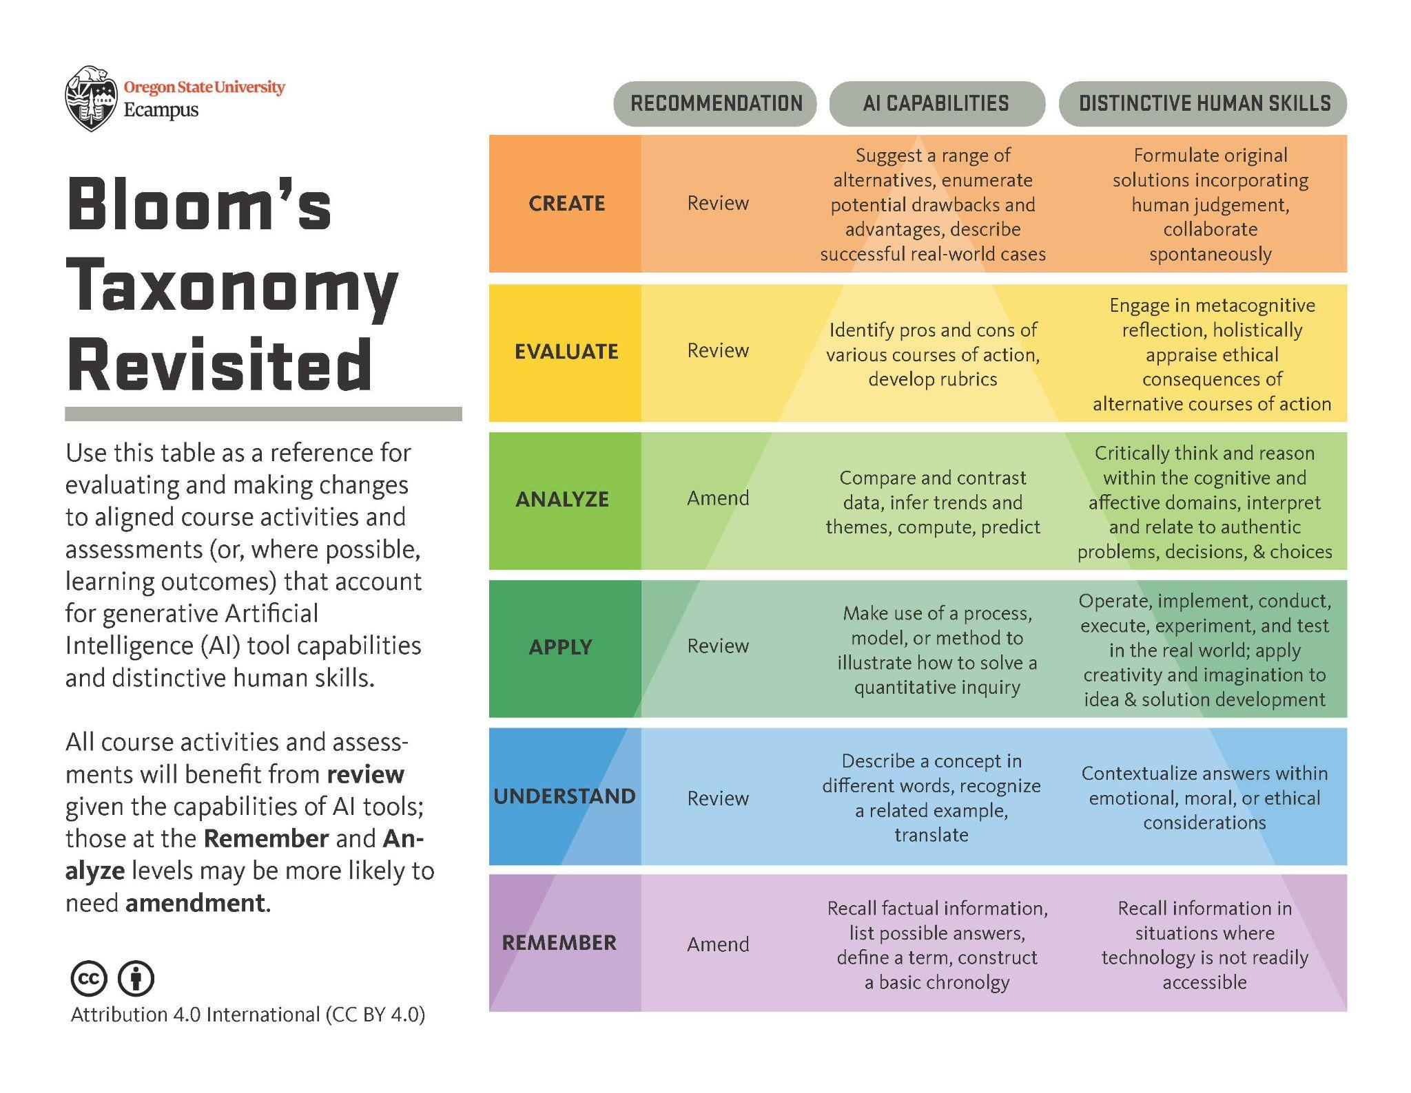
For thorough explanations of this graphic and how you can use it to update your assessment prompts, click here

Slide 98
#2: Consider Changing the Artifacts to
enhance students’ intrinsic motivations to learn
  Make assessments more meaningful/authentic
  Give them some choice and control within the learning outcomes
    e.g., if “learning to write an essay” isn’t the learning objective, perhaps the nature of artefact could be chosen by the student
    change written reflections or short answers to mindmaps or oral recordings
  Consider scaffolding - instead of 3 separate assessments, design one major one with formative assessments that take the student step-by-step through the process
increase accountability for the learning
  Online annotations with Perusall or Hypothes.is.
  Peer Reviews
  Group work in class (active learning)
  In-class discussions of artefacts
  Focus on process, not products
    Have students write in google docs and submit the url for you to check their version history
    require students to submit video explaining their artefact (using Microsfot Flip or Kaltura in Canvas)
secure the assessments (see Entry Point #4)

Slide 99
Updated Artefacts (from those previously seen on Slide 48)
Bloom’s Level | Example | Original Assessment Artefacts | Updated Artefacts
Analyze | Compare and contrast different forms of government and the significant historical figures represented with each regime. | Literature review, concept map, debate, case study, research paper, discussion forums | Formative = student choice of artefact Summative = oral presentation (whether to entire class or just small groups)
Apply | Write an argument supporting a political party platform and integrate relevant evidence from the texts. | Essay, presentation, scenario response, short answer response | Formative = give students choice over artefact (e.g., recorded video, PPT, essay) Summative = essay using Draftback (tracks revisions) with possible oral follow-up
Understand | Explain contrasting political theories from different vantage points. | Discussions, reading summaries, identifying political theories, concept map, true or false quiz questions, group discussion | Formative = in-class discussion, each group member takes on a different political role from which they explain a political theory Summative = secure, in-class quiz
Remember | Define relevant vocabulary for international affairs discourse. | Multiple choice, fill in blank, recite, word/definition match, polling questions | Formative = fun, in-class, flash card activity Summative = Secure, in-class quiz

Slide 100
#3: Tweak Assessments to Allow GenAI Use
Writing Support
Research assistance
Language translation
Writing improvement
Writing assistance
  Require students to use Lex, a GPT powered AI that enables students to show what was written by AI vs what they wrote.
See Wakefield’s A.I. Tool Guidelines for more ideas of ways students may be able to use AI Tools for academic work.
https://unf.pressbooks.pub/chatgptinhighereducation/chapter/chapter-1/

Slide 101
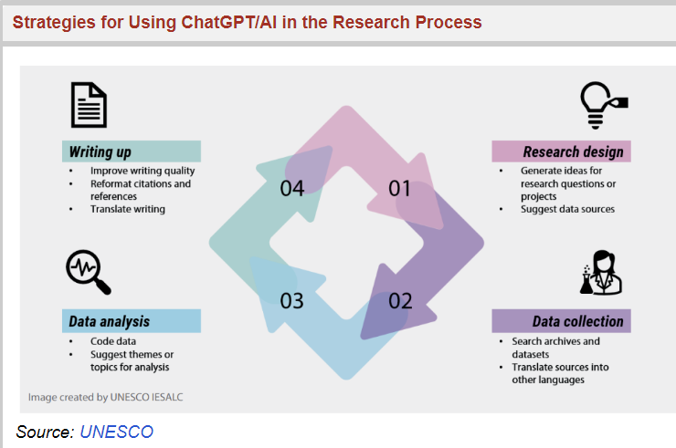
Example: Using GenAI in the Research Process

Slide 102
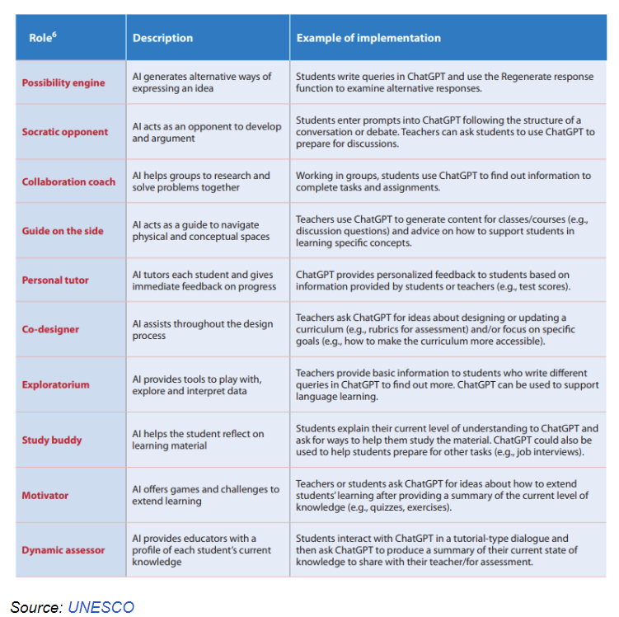
Example: Other Possible Uses of GenAI

Slide 103
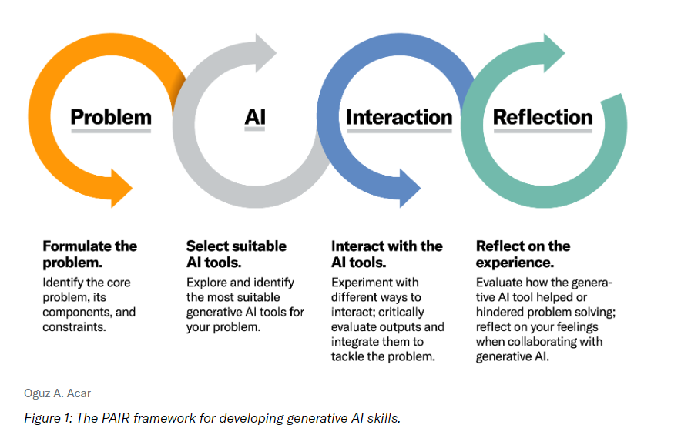
Example: Incorporate GenAI into the Assessment
Click on the image to read the article that gives an assignment example using the PAIR framework, and for best practices in using this framework for incorporating GenAI into your assessment
See Watkins’ Update Your Course Syllabus for ChatGPT - Get Creative with Your Assignments for more ideas of how to incorporate GenAI into your class

Slide 104
Updated Assessments with GenAI Use
Bloom’s Level | Example | Updated Assessment with GenAI Use
Create | Develop and defend a policy brief informed by existing political phenomena.
Evaluate | Assess an existing political institution and recommend evidence-based modifications to improve democratic governance.
Analyze | Compare and contrast different forms of government and the significant historical figures represented with each regime.
Apply | Write an argument supporting a political party platform and integrate relevant evidence from the texts. | Prompt a GenAI tool to take on a particular political party platform. You assume one that is in opposition. (E.g., pro-life versus women’s choice). Tell the tool that you are going to debate - you go first. Go at least 5 rounds with the tool. Review the debate, critique the tool’s arguments, and write up your reflection on the experience. Turn in the chat history, along with your write-up. (Bloom’s Level = Apply, Analyze & Evaluate)
Understand | Explain contrasting political theories from different vantage points.
Remember | Define relevant vocabulary for international affairs discourse. | Use GenAI tool to generate the relevant vocabulary. Critique the list according to what you’ve learned in class; make corrections as needed. Come to class prepared to use this vocabulary when you have a small group discussion about a current international issue. Submit your list, your critique, and notes and reflection of the group’s discussion (Bloom’s Level = Apply and Evaluate)

Slide 105
#4 Reconsider the Grading Structure
For any assessment that is not secure, change it from a summative to formative assessment
  Focus is on giving feedback to facilitate and improve learning
  Remove or reduce grades for those assessments
Develop Assessment Rubrics
  Rubrics communicate expectations for mastery the intended learning outcomes
  Share with students ahead of assessment completion - help students focus on the learning
  Used to evaluate the level of mastery after the assessment is completed
    Holistic Rubrics for formative assessments
    Analytic Rubrics for summative assessments
Raise the bar on levels of mastery
  If GenAI can generate a C or B level paper, than change the rubric to require more from students than what a machine can do
https://unf.pressbooks.pub/chatgptinhighereducation/chapter/enhancing-teaching-and-learning/#rubrics

Slide 106
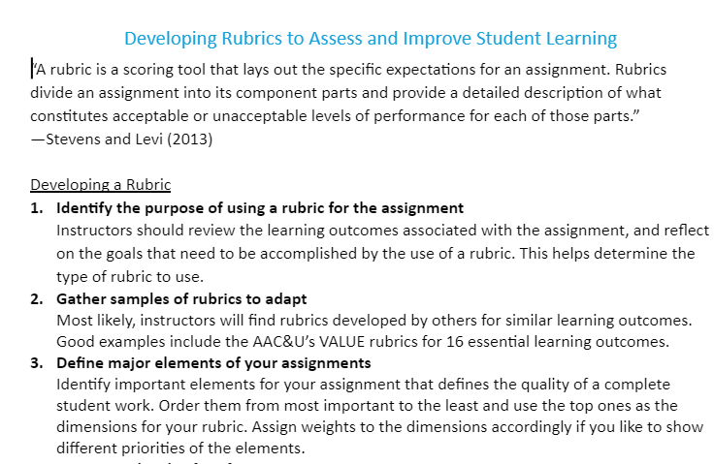

Need Help Creating Rubrics?
Use this handy Guide from the Commons
Ask ChatGPT-4 for help

Slide 107
Ethical Caveats
Keep diversity and disabilities in mind when re-designing assessments
Paid GenAI tools are better than the free ones - if you require GenAI Tools, make sure the requirement is equitable
GenAI tools are fraught with their own ethical concerns - prepare alternative assessments for those students who don’t want to use them
At least one summative assessment (end of quarter) should be secure to ensure that your assessment of student learning is valid (see next section on Assessment Security)

Slide 108
Entry Point #3: Redesigning Assessments
The box in green is where you’re headed next if you continue to progress through the slides. Otherwise, you can click on the next topic you want to explore.
What are Assessments
Why Rethink Assessments
How to Redesign Assessments
Additional Readings
Practical Ideas for Updating Assessments
Next Step

Slide 109
Additional Readings
Scholarly Articles/Chapters
Scaling up assessment for learning: progress and prospects
Cognitive Offloading and Assessment
Hello GPT! Goodbye home examination? An exploratory study of AI chatbots impact on university teachers’ assessment practices
Opinions on the Impact of GenAI on Assessments
Cynthia Alby’s ChatGPT: Understanding the new landscape and short-term solutions
Assessments and GenAI
The Role of Quality Assessment Design in Strengthening Academic Integrity
We Must Still Make Students Write
Practical Ideas
Assigning AI: Seven Ways of Using AI in Class
University of Texas Tips for Writing Assignment Prompts
University of Arizona Writing an Assignment Prompt & Rubric
Responding to Generative AI for assessments (from University of Sydney)
Scaffolding as a RoadMap: Guiding and Supporting Student Learning

Slide 110
Will GenAI use undermine the course learning outcomes?
Can the learning outcomes be revised?
Revise the learning outcomes
YES
YES
NO
NO
Can the assessments be redesigned?
Redesign the assessment(s)
YES
Next entry point
NO
Will GenAI use undermine assessment validity?
Secure the Assessment(s)
YES
Allow GenAI Use
Craft Your GenAI & AI Policy
NO

Slide 111
Entry Point #4
Securing Assessments

Slide 112
Entry Point #4: Securing Assessments
Choose where to start by clicking on the box you want to explore.You can progress through the slides in order as well. The green topic box is the next topic.
Why do I need to secure assessments
Why not just create an integrity culture
What assessments should be secure
Additional Readings
How can assessments be secured

Slide 113
Why do I have to Secure Assessments?
You don’t have to secure all assessments - just those that must be valid measures of the students’ mastery of learning outcomes (e.g., summative assessments)
Where you can, revise learning outcomes, redesign assessments, and create cultures of integrity, but assessment security begins where academic integrity ends (Phillip Dawson)
Where you must, secure assessments so that you know they’re being completed in the way you intended (reliability) and they are measuring what you designed them to measure (validity)

Slide 114
Entry Point #4: Securing Assessments
The box in green is where you’re headed next if you continue to progress through the slides. Otherwise, you can click on the next topic you want to explore.
Why do I need to secure assessments
Why not just create an integrity culture
What assessments should be secure
Additional Readings
How can assessments be secured

Slide 115
Why not just create a culture of integrity (and trust students)?
You should work to create a classroom culture of integrity (see next section on Crafting the GenAI & AI Policy)
  Doing so could impact student choices & is a good thing!
But for those assessments that really matter - that’s not sufficient
Trusting students not to cheat isn’t fair to the students who don’t cheat no matter what
For all other human behaviors, we understand that people need help sticking to their goals or keeping their promises
  E.g.: I would like to trust myself to avoid snacking, but to really prevent myself from doing so, I don’t put the snacks in my house!
Sometimes students need help to refrain from engaging in behaviors that won’t serve them well in the long run

Slide 116
Entry Point #4: Securing Assessments
The box in green is where you’re headed next if you continue to progress through the slides. Otherwise, you can click on the next topic you want to explore.
Why do I need to secure assessments
Why not just create an integrity culture
What assessments should be secure
Additional Readings
How can assessments be secured

Slide 117
Assessments that should be Secured are those that:
evaluate, rather than facilitate or improve learning
determine if a student is ready to progress into the next course in the sequence
predict a student’s ability to succeed in a particular genre/discipline (e.g., math placement tests)
require a restriction of cognitive offloading (because the lower level knowledge is being assessed)
have to be reused term after term with few changes
result in degrees being granted (e.g., theses, culminating exams, capstone projects, dissertations)

Slide 118
Entry Point #4: Securing Assessments
The box in green is where you’re headed next if you continue to progress through the slides. Otherwise, you can click on the next topic you want to explore.
Why do I need to secure assessments
Why not just create an integrity culture
What assessments should be secure
Additional Readings
How can assessments be secured

Slide 119
How to Secure Assessments
Use the Triton Testing Center (for make-up and accommodated tests)
Oral assessments
Interactive oral assessments
Two-stage exams
Individualized Assessments (e.g., PrairieLearn)
In-Class Proctoring
Online Tools (e.g., Lockdown Browser; Remote Proctoring)

Slide 120
Entry Point #4: Securing Assessments
The box in green is where you’re headed next if you continue to progress through the slides. Otherwise, you can click on the next topic you want to explore.
Why do I need to secure assessments
Why not just create an integrity culture
What assessments should be secure
Additional Readings
How can assessments be secured
Next Step

Slide 121
Additional Readings
Generative artificial intelligence and assessment security
A really thorough site exploring the potential risks to academic integrity & security, as well as the potential tips & mitigation strategies for all types of assessments:
  Quizzes
  Exams
  Written tasks
  Presentations and performances
  Coding tasks
  Labs/Practicals
  Graphical artefact/resource
Thoughts About Remote Proctoring Using Third Party Services
Remote Proctoring: Understanding the Debate
The Good and Bad of Online Proctoring

Slide 122
Will GenAI use undermine the course learning outcomes?
Can the learning outcomes be revised?
Revise the learning outcomes
YES
YES
NO
NO
Can the assessments be redesigned?
Redesign the assessment(s)
YES
NO
Will GenAI use undermine assessment validity?
Secure the Assessment(s)
YES
Final entry point
Allow GenAI Use
Craft Your GenAI & AI Policy
NO

Slide 123
Entry Point #5
Crafting Your GenAI & AI Policy

Slide 124
Entry Point #5: Crafting your GenAI & AI Policy
Choose where to start by clicking on the box you want to explore.You can progress through the slides in order as well. The green topic box is the next topic.
Why a Written Policy is Needed
Choose a Policy Path
Practical Ideas for Crafting your Policy
Additional Readings

Slide 125
Why a Written Policy is Needed

Slide 126
Students Will Cognitively Offload to Machines
Reasons For Cognitive Offloading (Aka Cheating) | What this Sounds Like | How GenAI “Helps”
Low Self-Efficacy | “There’s no way I can do this”. | Does the task for them & may give them the false sense that they know what they’re doing
Ethically unaware | “I didn’t know it was considered cheating!” | GenAI, like the “Help me Write” button in Google Docs, seems harmless, like using spell or grammar check.
Peer Effects | “My friends are using it, so that must mean it’s okay!” | GenAI feels like just another friend that students can turn to when they’re struggling.
Motivation | “I’ve got to get a good grade in this course!” | The GenAI focus on generating output reinforces the student’s own extrinsic orientation to producing products rather than learning
Procrastination | “I don’t have time to finish this assignment!” | GenAI can quickly generate a product that the student can submit as their own
Instructor Effects | “This is a stupid assignment that I don’t care about anyway” | If the students don’t find value or meaning in the assessment, they’ll offload it to GenAI

Slide 127
Why You Need a Written Policy
Students will use the opportunity to cognitively offload if it hasn’t been made clear that it isn’t allow
Students are already using the tools, and they have been consistent in asking for guidance from faculty of if, when, and how they can use it
We are in unknown territory here - hard for people to decide if GenAI is ethical/appropriate to use or not
As GenAI gets further integrated into existing systems (like spell check), it will become even harder to see the line between ethical and unethical
Faculty have different opinions and rules - students should not have to guess what is allowed in one class vs. another, or on one assessment or another
You need to communicate your expectations because they are directly tied to course learning outcomes and assessments
Senate Academic Integrity Policy requires rules to be in writing

Slide 128
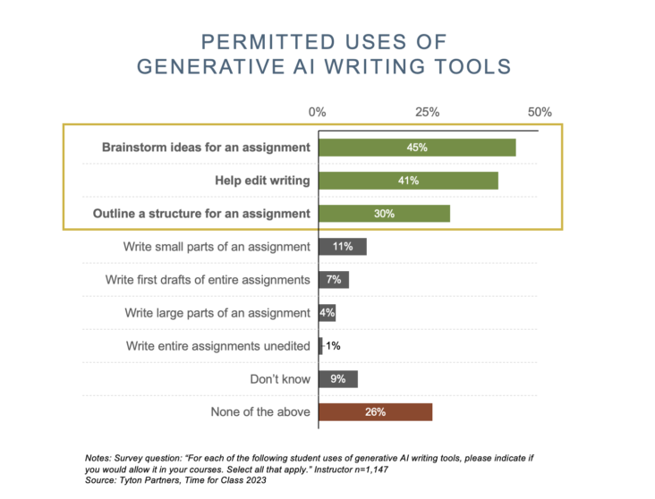
There is disagreement among faculty about if and how GenAI should be used

Slide 129
Questions to Consider in Deciding Your Policy
Given the course learning outcomes and purpose of the assessments (formative vs. summative), what constitutes “appropriate” and “ethical” use of GenAI tools in your classroom?
What is “work” on this assessment?
  (students say “I never would ask it to do my work for me)
What does “do your own work in our own words” mean in this course and on these assessments?
Is there a certain percentage of AI use that’s permitted?
  Why?
What, if any, is the difference between AI-assistance (spell and grammar checks; research aids; reference formatting) and AI-generated language (content creation) within the framework of your course?

Slide 130
Entry Point #5: Crafting your GenAI & AI Policy
The box in green is where you’re headed next if you continue to progress through the slides. Otherwise, you can click on the next topic you want to explore.
Why a Written Policy is Needed
Choose a Policy Path
Practical Ideas for Crafting your Policy
Additional Readings

Slide 131
Choose a Policy Path

Slide 132
Click on the diamond to take you down that path
Banned
Conditional
Allowed
You determined that the course learning outcomes & assessments would be undermined by GenAI use
You determined that GenAI will not undermine learning outcomes if it is used in certain ways, for certain tasks, and/or on particular assessments
You determined that GenAI use will not undermine any of the course learning outcomes & assessments

Slide 133
Crafting Your Banned Policy

Slide 134
Crafting Your Banned Policy
Be clear on the WHY
  E.g., Generative AI output is NOT your work, even if your prompts led to the output. If you submit this output as if it is yours, that’s misrepresenting your knowledge and abilities. It is dishonest.
  E.g., the knowledge we’re teaching in this course is fundamental - you need to know it to be able to accomplish more complex tasks later
  E.g., GenAI tools hallucinate and aren’t trained to be truthful. So, in order to use GenAI output later, you need this fundamental knowledge to know when the GenAI output is incorrect
Be specific on what tools are not allowed or for what purposes
  E.g., “you cannot use any person or machine to create content for you that you then submit as your own. So, on this assignment, for example…..”
  Students are already using some tools (e.g., Grammarly to “help” with their writing), so make sure you address the most commonly used ones
  This is why talking to your students before finalizing your policy can be helpful
State that you have the right to follow-up with an oral conversation to assess their learning

Slide 135
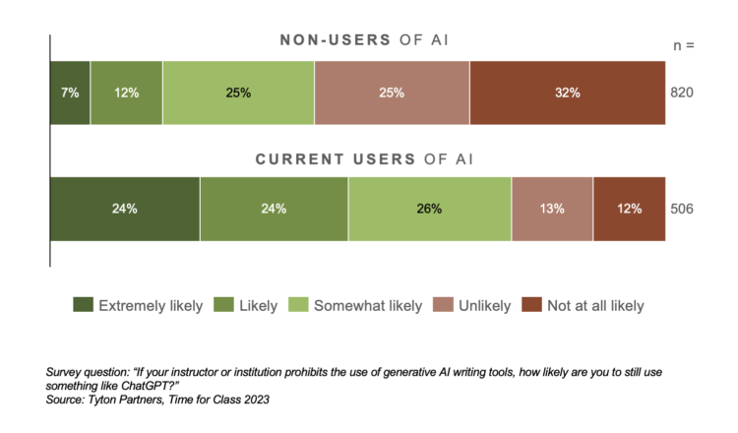
CAVEAT: Banning unlikely to work
Students Likely to Use it Anyway
Its Use is Difficult to Detect
Detectors are often wrong
Detectors are easily fooled
Detectors may be more likely to say something written by a non-native English writer is AI-generated
Faculty don’t seem to be any better at detecting
Banning without enforcement creates an unfair learning environment.
If you won’t be enforcing the ban,
reconsider your policy or secure your assessments.

Slide 136
Example Banned Statements
Example #1 (from Macalester College)
Using AI can impede your learning. The assignments in this class challenge you to develop creativity, critical-thinking, and problem-solving skills that AI does not have. Using AI technology could limit your capacity to do this type of work, and as the instructor, I urge you not to miss out on the educational opportunities that this course will provide. As is the case for all courses at Macalester College, work submitted by you for this class should reflect both your own ideas and your own language and you should properly cite any resources you have consulted. If you have any questions about citation or about what constitutes academic honesty in this course or at Macalester College in general, please feel free to raise these questions in class and/or contact me to discuss your concerns.
Example #2 (From unknown institution)
All cases of academic misconduct will be referred to the Office of Student Conduct. Academic Misconduct includes (but is not necessarily limited to) using ideas, words, images, or content in any other media that you did not create and presenting that content as if you were the creator. Copying content that other people created–either directly or in a modified form–without properly acknowledging the creator qualifies as academic misconduct, as does utilizing unauthorized digital tools such as artificial intelligence to create content. An assignment that is found to have been plagiarized or to have used unauthorized tools will automatically receive a zero and you will not be given an opportunity to repeat the assignment for a passing grade. Depending on the severity of the case, academic misconduct may result in a failing grade in the course.
Sourced from https://docs.google.com/document/d/1RMVwzjc1o0Mi8Blw_-JUTcXv02b2WRH86vw7mi16W3U/edit

Slide 137
Example Banned Statements
Example #3 (from Texas Woman’s University, Ann Davis)
All assignments in this course are individual assignments. In this class, you will often be discussing course concepts with your classmates and with me, but when you sit down to complete a quiz, write a discussion post, or work on a project, I expect you to do the actual work independently. This is the only way that I will be able to tell what you have learned.
You may not use non-TWU “tutoring services” such as Chegg or Course Hero for this course. Paying someone else to do your classwork is the opposite of learning.
You may not use artificial intelligence tools to complete your assignments in this course.
Your major projects in this course are open-book and open-note. However, plagiarism from any source is prohibited, both by university policy and by federal law. Any written assignments, including quizzes, projects, and discussion posts, must be your own, original work. You cannot directly copy word-for-word from any source, including a textbook, even if you provide a citation. Copying someone else’s words denies credit to the original author, and it also robs you of the opportunity to deepen your understanding by putting things in your own words. We will be using the Turnitin tool on many assignments in this course as a way to teach you to identify and avoid plagiarism. You will be able to see your similarity report as soon as you submit an assignment. If you notice that you have accidentally committed plagiarism, you should rewrite your assignment and resubmit it. If I notice that you have accidentally plagiarized, I will contact you and ask you to rewrite and resubmit, and I will not grade your assignment until I receive your new submission.
Sourced from https://docs.google.com/document/d/1RMVwzjc1o0Mi8Blw_-JUTcXv02b2WRH86vw7mi16W3U/edit

Slide 138
UC San Diego Banned Statement Template
(cite: UC San Diego & University of Waterloo Academic Integrity Offices)​
This course includes the independent development and practice of specific knowledge and skills, such as [fill this in with your learning outcomes]. Therefore, the use of Generative artificial intelligence (GenAI) trained using large language models (LLM) or other methods to produce text, images, music, or code, like Chat GPT, DALL-E, or GitHub CoPilot, is not permitted in this class. Unauthorized use in this course, such as running course materials through GenAI or using GenAI to complete a course assessment is considered a violation of the University’s Academic Integrity Policy. Work produced with the assistance of AI tools does not represent your original work and is therefore in violation of the fundamental values of academic integrity including honesty, trust, respect, fairness, responsibility and courage (ICAI, n.d.).​
​You should be prepared to show the learning process behind the work you submit. To demonstrate your learning, you should keep your rough notes, including research notes, brainstorming, and drafting notes. You may be asked to submit these notes along with earlier drafts of their work, either through saved drafts or saved versions of a document. If the use of GenAI is suspected where not permitted, you may be asked to meet with me to provide explanations and to support the submitted material as being your original work. Through this process, if you have not sufficiently supported your work, I may need to report the matter to the Academic Integrity Office. In addition, you should be aware that the legal/copyright status of generative AI inputs and outputs is unclear. ​
You are encouraged to reach out to me or the TAs for support, or reach out to any of the following UC San Diego academic support centers for academic assistance:​
The Commons’ Academic Achievement Hub for Learning Strategies, Content Tutoring or Supplemental Instruction
The Commons’ Writing Hub for help with writing or other types of communication (e.g., presentations)
The Library for research-based assignments
The Academic Integrity Office for questions about ethical use of GenAI

Slide 139
Detecting Integrity Violations when GenAI Use Not Permitted
Adapted from Cotton, Cotton & Shipway (2023), there are a few signs that an academic assessment has been produced by a GenAI chatbot::
Language patterns or irregularities: chatbots often have limited language abilities and may produce repetitive phrases or words, with odd or inconsistent use of language.
Inaccurate or Unusual sources and citations: work written by a chatbot may include fake or irrelevant citations, and usually not those associated with the course
Lack of originality: depending on the topic, the output produced by a chatbot may not be that original; using Turnitin can still potentially help check for copying/plagiarizing
Factual errors: chatbots often produce text that is factually inaccurate or inconsistent
Blandness: chatbot output is usually quite generic and not connected to the particular context of your course
Off-topic: the content is slightly or fully off-topic, not addressing the prompt or even related to what was taught in the class
If any of these signs are present, talk with the student about their assessment before reporting to the AI Office:
What was your process for completing this assignment?
Do you have your notes, version history?
Why did you choose X instead of Y?
Tell me more about this source - why did you use it instead of one of the ones from class?
Did you use a GenAI tool to produce any of this content?
  If yes, please share the output from the tool so we can see your process & the changes you made
Click here to skip past Conditional and Allowed Use Policies to Practical Ideas

Slide 140
Crafting Your Conditional Policy

Slide 141
Crafting Your Conditional Use Policy
Determine which learning outcomes would be undermined by GenAI use and which ones wouldn’t be
Discuss when GenAI use would cross a line from acceptable to cheating
  E.g., using it to generate topic ideas for a paper is fine, but using it to generate content is not fine
Identify when GenAI use would reduce the labor of a task without undermining learning or enabling students to learn more with the same labor
List out if there are specific tools allowed and for what purposes (e.g., ResearchRabbit for finding scholarly research)
Require proof of how it was used
  e.g., students have to submit their Chat History with their assignment and a meta-reflection on how they used the tool and how it helped, or didn’t help, their learning
Tell students that you reserve the right to follow-up with an oral conversation to assess their learning
Include this statement: “For more guidance on using GenAI, check out this Guide from our Library”
Thanks to Brandauer & Forbes for some of these ideas

Slide 142
Requiring Transparency about GenAI Use
Require students to explicitly share whether or not they used ChatGPT or another AI technology in specific assignment/activity:
Example from University College London:
You must acknowledge its use – name the tool and how it was used using the following style.
  No content generated by AI technologies has been presented as my own work
  I acknowledge the use of <insert AI system(s) and link> to generate materials for background research and self-study in the drafting of this assessment.
  I acknowledge the use of <insert AI system(s) and link> to generate materials that were included within my final assessment in modified form.
Require students to explicitly share prompts, outputs, and modifications:
Example from University College London:
You must describe how the information or material was generated (including the prompts you used), what the output was and how the output was changed by you. You should use the following style of wording, depending on the nature of use:
  The following prompts were input into <AI system>: <List prompt(s)>
  The output obtained was: <Paste the output generated by the AI system>
  The output was changed by me in the following ways: <explain the actions taken>
Above is copied from https://docs.google.com/document/d/1luwax_ps5tqRGBL4XWyr_Y_ab8h7Y7k6bsp4v1-pIRc/edit

Slide 143
Example Conditional Use Statements
ARTIFICIAL INTELLIGENCE (AI) USE POLICY (Macalester College)
Example #1
AI can both interfere with and enhance our capacity to learn. We must be mindful of when it might hinder us and when it might provide us with new understanding and/or assistance. In specific situations and contexts within this course you will be asked to use AI tools to explore how they can be used, what their limits are, and how to use them ethically. Please remember that any idea or language that is not your own needs to be correctly cited in work that you submit in this course and at Macalester College in general. This policy covers all types of AI: text, code, images, video, audio, and translation.
[You might want to include more specific guidelines about AI-generated text/code and/vs AI-assistance–are they both acceptable? Under what circumstances?]
Example #2
In this course, you may use AI tools (such as Bard or ChatGPT) to help you generate ideas and to brainstorm. However, you should note that the material generated by these tools may be inaccurate, incomplete, or otherwise problematic. Beware that overuse of AI may stifle your own independent thinking and creativity, and use any tools (for generating text, code, video, audio, images, or translation) wisely and carefully.
You may not submit any work generated by an AI program as your own. If you include material—including both ideas and language—generated by an AI program, it should be cited like any other reference material, both in this course and at Macalester College in general. If you have any questions, please feel free to contact me.

Slide 144
Example Conditional Use Statements
Example #3 (From George Washington University, Alexa Alice Joubin)
Using an AI-content generator such as ChatGPT to complete assignment without proper attribution violates academic integrity. By submitting assignments in this class, you pledge to affirm that they are your own work and you attribute use of any tools and sources.
Learning to use AI responsibly and ethically is an important skill in today’s society. Be aware of the limits of conversational, generative AI tools such as ChatGPT.
Quality of your prompts: The quality of its output directly correlates to the quality of your input. Master “prompt engineering” by refining your prompts in order to get good outcomes.
Fact-check all of the AI outputs. Assume it is wrong unless you cross-check the claims with reliable sources. The currently AI models will confidently reassert factual errors. You will be responsible for any errors or omissions.
Full disclosure: Like any other tool, the use of AI should be acknowledged. At the end of your assignment, write a short paragraph to explain which AI tool and how you used it, if applicable. Include the prompts you used to get the results. Failure to do so is in violation of academic integrity policies. If you merely use the instructional AI embedded within Packback, no disclosure is needed. That is a pre-authorized tool.
Here are approved uses of AI in this course. You can take advantage of a generative AI to:
Fine tune your research questions by using this tool https://labs.packback.co/question/ Enter a draft research question. The tool can help you find related, open-ended questions
Brainstorm and fine tune your ideas; use AI to draft an outline to clarify your thoughts
Check grammar, rigor, and style; help you find an expression
Example #4 (from Chandler Gilbert Community College, Miguel Fernandez)
1)Using a product or technology (ChatGPT, Dall-E, etc.) in the course to create or aggregate synthetic content for the course such as any course writing, brainstorming, generating a draft, a works cited source bank, answering discussion groups, substitute or impersonate you in zoom, classroom, breakout rooms, collaboration, group work, or other attendance activities, is considered academic misconduct similar to plagiarism or violations of the honor code.
2)Using a product or technology as identified above to help you edit your work (improve your quality as defined by course instruction, course definitions, standards & expectations, and rubrics) is not a violation of the honor code statement, as long as you cite the tool or identify it as a partner or augmentation in use for a course related activity before submitting your work.
Sourced from https://docs.google.com/document/d/1RMVwzjc1o0Mi8Blw_-JUTcXv02b2WRH86vw7mi16W3U/edit

Slide 145
Example Conditional Use Statements
Example #5 (From Bentley University, Chris Beneke)
Writing is integral to thinking. It is also hard. Natural language processing (NLP) applications like ChatGPT or Sudowrite are useful tools for helping us improve our writing and stimulate our thinking. However, they should never serve as a substitute for either. And, in this course, they cannot.
Think of the help you get from NLP apps as a much less sophisticated version of the assistance you can receive (for free!) from a Bentley Writing Center tutor. That person might legitimately ask you a question to jump-start your imagination, steer you away from the passive voice, or identify a poorly organized paragraph, but should never do the writing for you. A major difference here, of course, is that an NLP app is not a person. It’s a machine which is adept at recognizing patterns and reflecting those patterns back at us. It cannot think for itself. And it cannot think for you.
With that analogy in mind, you will need to adhere to the following guidelines in our class.
Appropriate use of AI when writing essays or discussion board entries
• You are free to use spell check, grammar check, and synonym identification tools (e.g., Grammarly, and MS Word)
• You are free to use app recommendations when it comes to rephrasing sentences or reorganizing paragraphs you have drafted yourself
• You are free to use app recommendations when it comes to tweaking outlines you have drafted yourself
•
Inappropriate use of AI when writing essays or discussion board entries
• You may not use entire sentences or paragraphs suggested by an app without providing quotation marks and a citation, just as you would to any other source. Citations should take this form: OpenAI, chatGPT. Response to prompt: “Explain what is meant by the term ‘Triple Bottom Line’” (February 15, 2023, https://chat.openai.com/).
• You may not have an app write a draft (either rough or final) of an assignment for you
Evidence of inappropriate AI use will be grounds for submission of an Academic Integrity report. Sanctions will range from a zero for the assignment to an F for the course.
I’m assuming we won’t have a problem in this regard but want to make sure that the expectations are clear so that we can spend the semester learning things together—and not worrying about the origins of your work.
Be aware that other classes may have different policies and that some may forbid AI use altogether
Sourced from https://docs.google.com/document/d/1RMVwzjc1o0Mi8Blw_-JUTcXv02b2WRH86vw7mi16W3U/edit

Slide 146
Example Conditional Use Statements
Example #6 (from Ohio State University, Inara Scott)
I expect you to generate your own work in this class. When you submit any kind of work (including projects, exams, quizzes, or discussions), you are asserting that you have generated and written the text unless you indicate otherwise by the use of quotation marks and proper attribution for the source. Submitting content that has been generated by someone other than you, or was created or assisted by a computer application or tool, including artificial intelligence (AI) tools such as ChatGPT is cheating and constitutes a violation of the Student Conduct Code. You may use simple word processing tools to update spelling and grammar in your assignments, but you may not use AI tools to draft your work, even if you edit, revise, or paraphrase it. There may be opportunities for you to use AI tools in this class. Where they exist, I will clearly specify when and in what capacity it is permissible for you to use these tools.
Example of guidance on individual assignments:
I want to address the new AI-tools that you may be hearing about, such as ChatGPT, and their possible role in this project. I want you to be aware that ChatGPT is based on a large language model--it is basically crowdsourcing information and providing likely answers based on the vast amount of text in its database. While it can provide some helpful information, and may spur your thinking in some areas, it is not a reliable source and cannot provide citations or references to reliable data or evidence. (If you ask it for a citation, be aware that it makes things up and the information it's giving you is likely garbage!)
So, can I use ChatGPT or other AI tools to help write this paper?
Things you can do: ask ChatGPT questions! I personally enjoy chatting with it about topics I'm interested in. For example, "What are some current issues related to sustainability in the airline industry?" When you read what it says, keep in mind that it's probably at least 60-70% correct, but perhaps not more than that. :-) Given that you're considering whatever it told you with a big grain of salt, you'll then need to do some research to find peer reviewed and reliable evidence that might corroborate (or disagree with!) what the AI tool told you. Use those articles to find other articles that consider the same question (review the citation list for other articles to read). Either before or after you ask ChatGPT a question, try a google search with the same sort of query and see what it turns up; also, try a search on the OSU library system. Review, compare, and investigate. Repeat this cycle, keeping in mind that what you're getting from AI is crowdsourced information, not the reliable product of research and assessment.
Things you cannot do: Do not use ChatGPT to draft your paper. Do not use ChatGPT to give you citations. I am saying this both for purposes of coming up with reliable evidence and also from an academic integrity (i.e, cheating) standpoint. If you didn't write it, don't put your name on it and claim that you wrote it. Don't modify a few words here and there and claim you wrote it either. Close the window before you start drafting and put the real evidence and articles you've found into your own words. Do your own analysis and critical thinking.

Slide 147
Example Conditional Use Statements
Example #7 (from Chandler Gilbert Community College, Miguel Fernandez)
1)Using a product or technology (ChatGPT, Dall-E, etc.) in the course to create or aggregate synthetic content for the course such as any course writing, brainstorming, generating a draft, a works cited source bank, answering discussion groups, substitute or impersonate you in zoom, classroom, breakout rooms, collaboration, group work, or other attendance activities, is considered academic misconduct similar to plagiarism or violations of the honor code.
2)Using a product or technology as identified above to help you edit your work (improve your quality as defined by course instruction, course definitions, standards & expectations, and rubrics) is not a violation of the honor code statement, as long as you cite the tool or identify it as a partner or augmentation in use for a course related activity before submitting your work.
Example #8 (from Plymouth State University, Pam Harland)
Within this course, you are welcome to use generative artificial intelligence (Ai) models (ChatGPT, DALL-E, GitHub Copilot, and anything after) with acknowledgment. However, you should note that all large language models have a tendency to make up incorrect facts and fake citations, they may perpetuate biases, and image generation models can occasionally come up with offensive products. You will be responsible for any inaccurate, biased, offensive, or otherwise unethical content you submit regardless of whether it originally comes from you or an Ai model.
If you use an Ai model, its contribution must be cited and discussed:
What was your prompt?
Did you revise the Ai model’s original output for your submission?
Did you ask follow-up questions?
What did you learn?
Having said all these disclaimers, the use of Ai models is encouraged, as it may make it possible for you to submit assignments and your work in the field with higher quality and in less time.
Sourced from https://docs.google.com/document/d/1RMVwzjc1o0Mi8Blw_-JUTcXv02b2WRH86vw7mi16W3U/edit

Slide 148
Example Conditional Use Statements
Example #9 from Marc Watkins
AI-Assisted Writing vs. AI-Generated Writing
With the rise of AI writing assistants, students must take special care to ensure that they use this new technology ethically and honestly. In our class, we will distinguish between 'AI-assisted writing' verses 'AI-generated writing'. AI-assisted writing is only permitted in this course provided a student uses an AI writing assistant as a collaborative tool to help the student with the development and advancement of their own writing process. Collaborating with an AI writing assistant can include brainstorming, outlining, and drafting, so long as there is substantial writing, research, and composing by the student which is not generated solely by the AI. 'AI-generated writing' means there has been little or no involvement from the student as an author, with the majority of the writing being generated by an AI. The goal of using AI-assisted writing in this class is to help students develop their writing process and critical thinking, not to replace or substitute for either. Therefore, using an AI to generate writing or compositions without substantial original contribution from a student is neither acceptable nor allowed.
Be Aware:
You will not be able to save anything the AI generates. If you want to use an idea or suggestion produced by the AI, you will need to copy and paste it into a Word.doc.
The AI output may contain material that is offensive, biased, or otherwise goes against the University Creed in practice, or material that is false or misleading or potentially harmful, or other problematic material the use of which may fall outside the protections of Academic Freedom and/or Free Speech--review all AI output carefully before using anything suggested by the AI within your academic work.
Acceptable | Not Acceptable
AI-Assisted Writing | AI-Generated Writing
Use AI-assisted writing to brainstorm Explore new topics/ideas with AI-assisted writing Use AI-assisted writing to explore potential counterarguments/ opposing points of view Resee your writing by taking suggestions from your AI assistant to make improvements | Cheat on the writing & research process Generate large chunks of text with little or no input from you as an author Trust something the AI has generated at face value Use AI-generated text as a substitute for research or critical thinking
Sourced from https://docs.google.com/document/d/1ggP_lQ5jeZSWTL2OP1rdgngt5sgbCC81/mobilebasic

Slide 149
UC San Diego Conditional Use Statement Template
(cite: UC San Diego & University of Waterloo Academic Integrity Offices)
Generative artificial intelligence (GenAI) tools like Chat GPT, DALL-E, or GitHub CoPilot, that generate output may be used in this course in limited ways with proper documentation, citation, and acknowledgement.
In accordance with our course learning outcomes, you may use the following GenAI tools in the following ways: [list them here].
As a way to demonstrate your honest use of these tools and your learning process, you must:
keep histories of your chats and submit them when requested
cite the content that came from the GenAI tool using citations methods endorsed by the Library
reflect on the process of using the GenAI tool by submitting your responses to these questions:
  list your questions
NOTE: GenAI is known to fabricate sources, facts, and give false information. It also perpetuates bias. You should also be aware that there are copyright and privacy concerns with these tools. You should exercise caution when using large portions of content from AI sources for these reasons. Also, you are accountable for the content and accuracy of all work you submit in this class, including any supported by generative AI.
You are encouraged to reach out to me or the TAs for support, or reach out to any of the following UC San Diego academic support centers for academic assistance:
The Commons’ Academic Achievement Hub for Learning Strategies, Content Tutoring or Supplemental Instruction
The Commons’ Writing Hub for help with writing or other types of communication (e.g., presentations)
The Library for research-based assignments
Click here to skip past Allowed Use Policies to Practical Ideas

Slide 150
Crafting Your Allowed Policy

Slide 151
Crafting Your Allowed Use Policy
You have designed or secured your assessments so that any GenAI use will either not undermine learning outcomes or will actually enhance their achievement
Explain how and why students are allowed to use GenAI tools
  Make sure to tie back to learning outcomes for the course, but also each particular assessment
Create at least one activity that prepares students to use the tools properly and critically
Ensure students know that they are responsible for what they submit, whether content was generated by GenAI or not
  So any inaccuracies, biases, mis/disinformation are the responsibility of the human author
To enhance critical thinking and AI literacy, require students to keep records of their chat history, version changes, etc, and acknowledge their use
  What tool was used
  How was it used
  How did it help them learn
  How did it hinder their learning
  How would they use it differently next time
Include this statement: “For more guidance on using GenAI, check out this Guide from our Library”

Slide 152
Allowed Use Policy Caveats
There are many ethical Concerns with GenAI
  Privacy
  Data security
    FTC investigates OpenAI over data leak and ChatGPT’s inaccuracy
  Equity issues
    Paid GPT4 is better than GPT3.5 (free), so will less affluent students be at a disadvantage in your class?
  Baked in biases
  Inaccurate information
Because of these concerns, instructors shouldn’t require its use but rather provide alternative options
You should teach students how to use GenAI tools effectively (next slide)

Slide 153
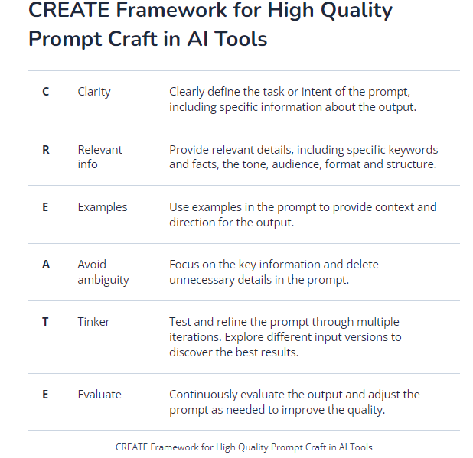
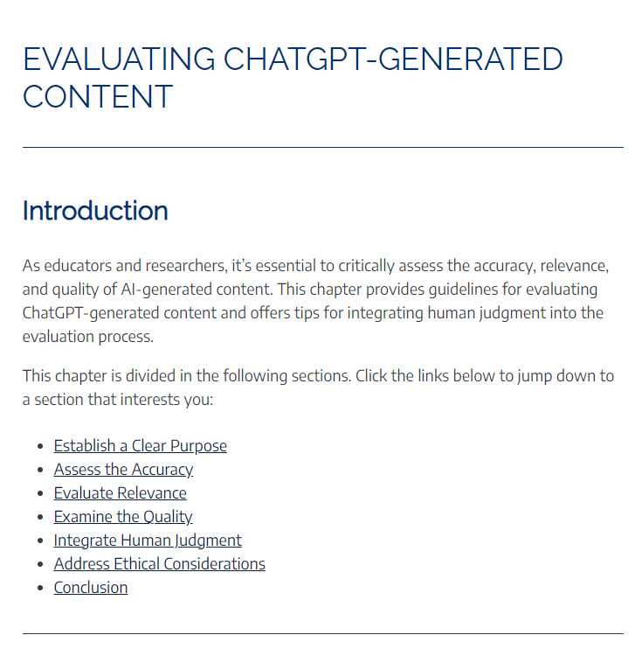
Teach students how to use the machines effectively
Teach Prompting
Teach Critical Thinking
From ChatGPT in Higher Education book
(image linked to source)
From Tom Barrett (image linked to source)

Slide 154
Example Allowed Use Statements
Example #1 (from Wharton School, Ethan Mollick)
I expect you to use AI (e.g., ChatGPT and image generation tools) in this class. In fact, some assignments will require it. Learning to use AI is an emerging skill and I provide tutorials on how to use them. I am happy to meet and help you with these tools during office hours or after class.
Be aware of the limits of ChatGPT, such as the following:
If you provide minimum-effort prompts, you will get low-quality results. You will need to refine your prompts in order to get good outcomes. This will take work.
Don’t trust anything it says. If it gives you a number or fact, assume it is wrong unless you either know the answer or can check with another source. You will be responsible for any errors or omissions provided by the tool. It works best for topics you understand.
AI is a tool, but one that you need to acknowledge using. Please include a paragraph at the end of any assignment that uses AI explaining what you used the AI for and what prompts you used to get the results. Failure to do so is in violation of academic honesty policies.
Be thoughtful about when this tool is useful. Don’t use it if it isn’t appropriate for the case or circumstance.

Slide 155
Example Allowed Use Statements
Example #2 (from State University of New York, Oswego, Mohammad Tajvarpour)
This course encourages and embraces the ethical use of Artificial Intelligence (AI). Throughout the course, it is essential to utilize generative AI systems, including but not limited to Text to Text, Text to Image, Text to Audio, and Image to Video, in a manner that upholds integrity.
As a student in this course, you are expected to actively incorporate AI tools while upholding integrity. You hold the responsibility to assess the integrity and impartiality of your submissions, ensuring they remain unbiased. It is important to recognize that AI has inherent limitations, and human supervision is necessary to verify the quality and appropriateness of the output. Thus, exercising responsible AI usage requires human oversight and verification.
Moreover, you are required to thoroughly read and certify the content of each submission. This entails a careful review to confirm the accuracy and suitability of the AI-generated content before submission.
AI Acknowledgement: To promote transparency, every assignment must include an ""AI Acknowledgement"" section. This section should clearly explain how AI was employed in the preparation and composition of the assignment. This acknowledgement allows us to acknowledge the role of AI in the learning process and understand its impact on the work produced.
By adhering to this AI policy, we aim to cultivate a learning environment where AI tools are utilized responsibly, ensuring the integrity of our work and promoting ethical AI practices throughout the course.
Sourced from https://docs.google.com/document/d/1RMVwzjc1o0Mi8Blw_-JUTcXv02b2WRH86vw7mi16W3U/edit

Slide 156
Example Allowed Use Statements
Example #3 (from Boston College Modern, Erin Baumann)
Understanding how to live and work with digital tools and platforms – from statistical software to data visualization tools to artificial intelligence tools – is an essential skill for all students in this day in age. In this course I encourage you to use all the tools available to you (and that you are familiar enough with to use efficiently and effectively) to aid your learning. This includes artificial intelligence (AI) copywriting and chatbot tools such as ChatGPT, Humata.ai, DALL-E 2, and others. However, as with any other resource you use to aid your work in this course, you must acknowledge any and all AI tools that you use in the development of your work. You must also substantially revise any writing or work produced by an AI tool before submitting it for credit in this course.
If you use an AI tool at any point in the development and/or creation of your work for this course – including discussion board posts, exams, and projects – you must include appropriate citations and the acknowledgment below in your Reference list:
Name of publisher/tool producer. (year). Name of AI tool (version date) [Large language model].
You must also include a full transcript of the writing or work produced by the AI tool in an appendix to your work.
For more details on how to cite ChatGPT and other generative AI tools see this resource from the American Psychological Association.
Sourced from https://docs.google.com/document/d/1RMVwzjc1o0Mi8Blw_-JUTcXv02b2WRH86vw7mi16W3U/edit

Slide 157
UC San Diego Allowed Use Statement Template
(cite: UC San Diego & University of Waterloo Academic Integrity Offices)
Generative artificial intelligence (GenAI) tools like Chat GPT, DALL-E, or GitHub CoPilot, that generate output may be used in this course as you determine appropriate, as long as you do so honestly through proper documentation, citation, and acknowledgement.
As a way to demonstrate your honest use of these tools and your learning process, you must:
keep histories of your chats and submit them when requested
cite the content that came from the GenAI tool using citations methods endorsed by the Library
reflect on the process of using the GenAI tool by submitting your responses to these questions:
  list your questions
NOTE: GenAI is known to fabricate sources, facts, and give false information. It also perpetuates bias. You should also be aware that there are copyright and privacy concerns with these tools. You should exercise caution when using large portions of content from AI sources for these reasons. Also, you are accountable for the content and accuracy of all work you submit in this class, including any supported by generative AI.
You are encouraged to reach out to me or the TAs for support, or reach out to any of the following UC San Diego academic support centers for academic assistance:
The Commons’ Academic Achievement Hub for Learning Strategies, Content Tutoring or Supplemental Instruction
The Commons’ Writing Hub for help with writing or other types of communication (e.g., presentations)
The Library for research-based assignments

Slide 158
Entry Point #5: Crafting your GenAI & AI Policy
The box in green is where you’re headed next if you continue to progress through the slides. Otherwise, you can click on the next topic you want to explore.
Why a Written Policy is Needed
Choose a Policy Path
Practical Ideas for Crafting your Policy
Additional Readings

Slide 159
Practical Ideas

Slide 160
Practical Idea: Talk with Your Students
Avoid crafting your GenAI & AI Policy yourself without student input
  Students are already using GenAI - perhaps you should find out if they understand what GenAI does and how it works, but also how & why they are currently using it
  Sample questions you might want to ask your students
    You could do this anonymously ahead of the first class
Talk to your students about GenAI & Academic Integrity
  They want to have these conversations
  Guiding Principles for talking with your students
  Refer students to this Library Guide on GenAI
Provide students with a resource to help them make decisions about GenAI Use - when it’s ethical and when it’s not - and then hold a class discussion about it
  You’re welcome to use this one!

Slide 161
Practical Ideas for Crafting Your GenAI & AI Policy
Use Pepperdine’s Syllabus Statement generator tool
  NOTE: the Turnitin Detection tool is not reliable and you don’t have access to it so please don’t include a statement that students work will be submitted to it
Consider Advice from Ethan Mollick
  Under what circumstances AI use is permitted or forbidden
  How students should cite or credit AI
  A warning about the technology’s tendency toward hallucination (i.e., deceptive data) and clear rules regarding students’ accountability for AI output
  A notice about using AI ethically and responsibly
  Discussion of the need to use AI as a tool to learn, not just to produce content
Ponder if any of these Do’s or Don’ts work for your class:
Do | Don’t
Ask for research guidance before writing Use it for brainstorming (like you would a friend) Ask questions about course concepts you don’t understand Proofread your work | Ask it to write your content for you Blindly trust AI-generated content Do anything that would violate course or institutional integrity standards

Slide 162
Entry Point #5: Crafting your GenAI & AI Policy
The box in green is where you’re headed next if you continue to progress through the slides. Otherwise, you can click on the next topic you want to explore.
Why a Written Policy is Needed
Choose a Policy Path
Practical Ideas for Crafting your Policy
Additional Readings
Next Step

Slide 163
Additional Readings
Detecting GenAI Output
AI-Detectors Biased Against Non-Native English Writers
Testing of Detection Tools for AI-Generated Text (research article)
OpenAI’s Blog - “How can educators respond to students presenting AI-generated content as their own?”
Listening to Students
What Students Said About the Spring of ChatGPT
Guides for Students
University of Sydney’s “Welcome to AI in Education”, a site for students built by students
Thompson Rivers University Library’s Artificial Intelligence: A Guide for Students
UC San Diego Library’s GenAI Guide for Students

Slide 164
Thank You!
We hope that this Guide was helpful, even if it raised more questions than it answered and therefore stimulated your learning and thinking.
This Guide will continually be updated, so bookmark it.
To provide feedback on the Guide or ask questions, or to join a Community of Practice, please contact us using this form.
For 1:1 guidance or to explore available workshops on any of these topics, contact any of the following:
Academic Integrity & Triton Testing
Engaged Teaching Hub
Writing Hub

Slide 165
Version Update Notes
Released September 17, 2023
This is where we’ll keep notes on updates made after the above date
9/29/23: Added Creative Commons licence; see Slide #2
Planned future updates:
  Adding video explainers for the different sections
  Adding in concrete examples from faculty as they share changes they’ve made

