Slide 1
Research Security:
A Vendor Perspective
THE x Digital Science Webinar
Shannon O’Reilly, Team Lead - Product Specialist
s.oreilly@digital-science.com
September 17, 2024
Notes:
Before I begin, I want to emphasize that we all want scientific research to be as open and collaborative as possible - it’s proven to drive innovation and discovery. And the majority of research partnerships have transparent intentions that provide mutual benefits to all research partners. However, some activities by foreign governments, militaries and other actors can pose real risks to national security and the integrity of the research ecosystem.

Slide 2
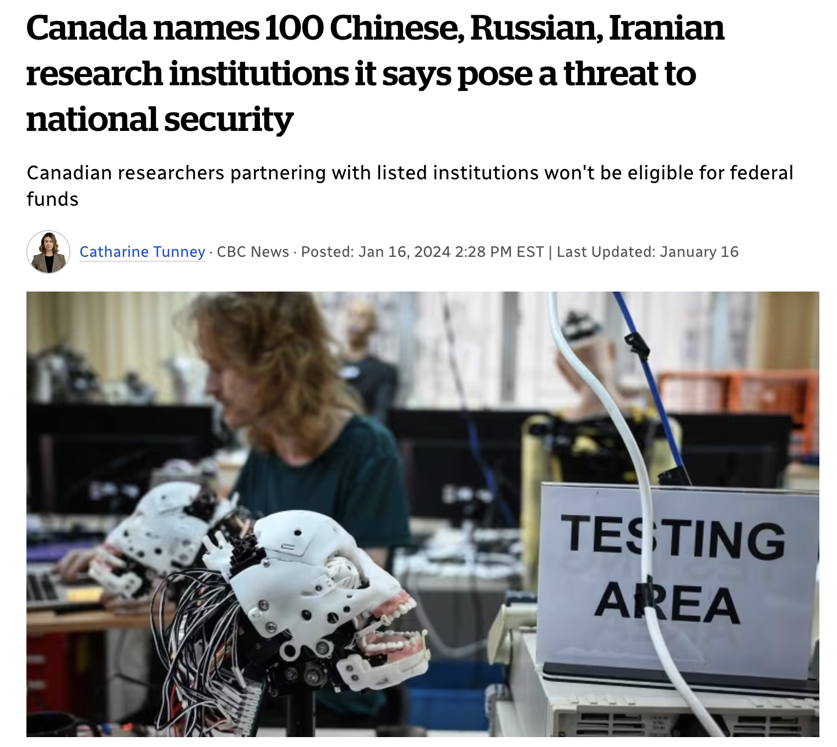
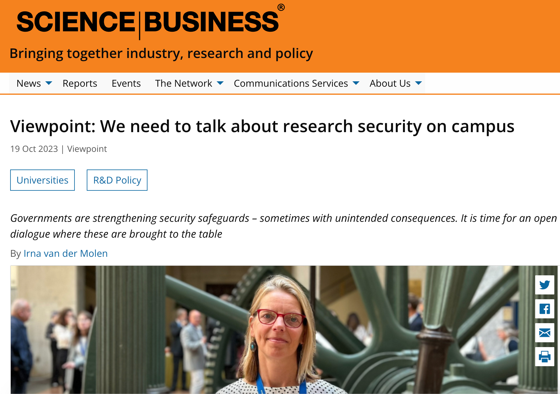
What’s at stake?
Notes:
Over time, the risks associated with research security have become more dynamic and complex. Poor adherence to government, funder and compliance mandates can put academic institutions at risk if they don’t comply, and face fines, penalties and reputational loss. The growing news stories around the world reflect this.

Slide 3
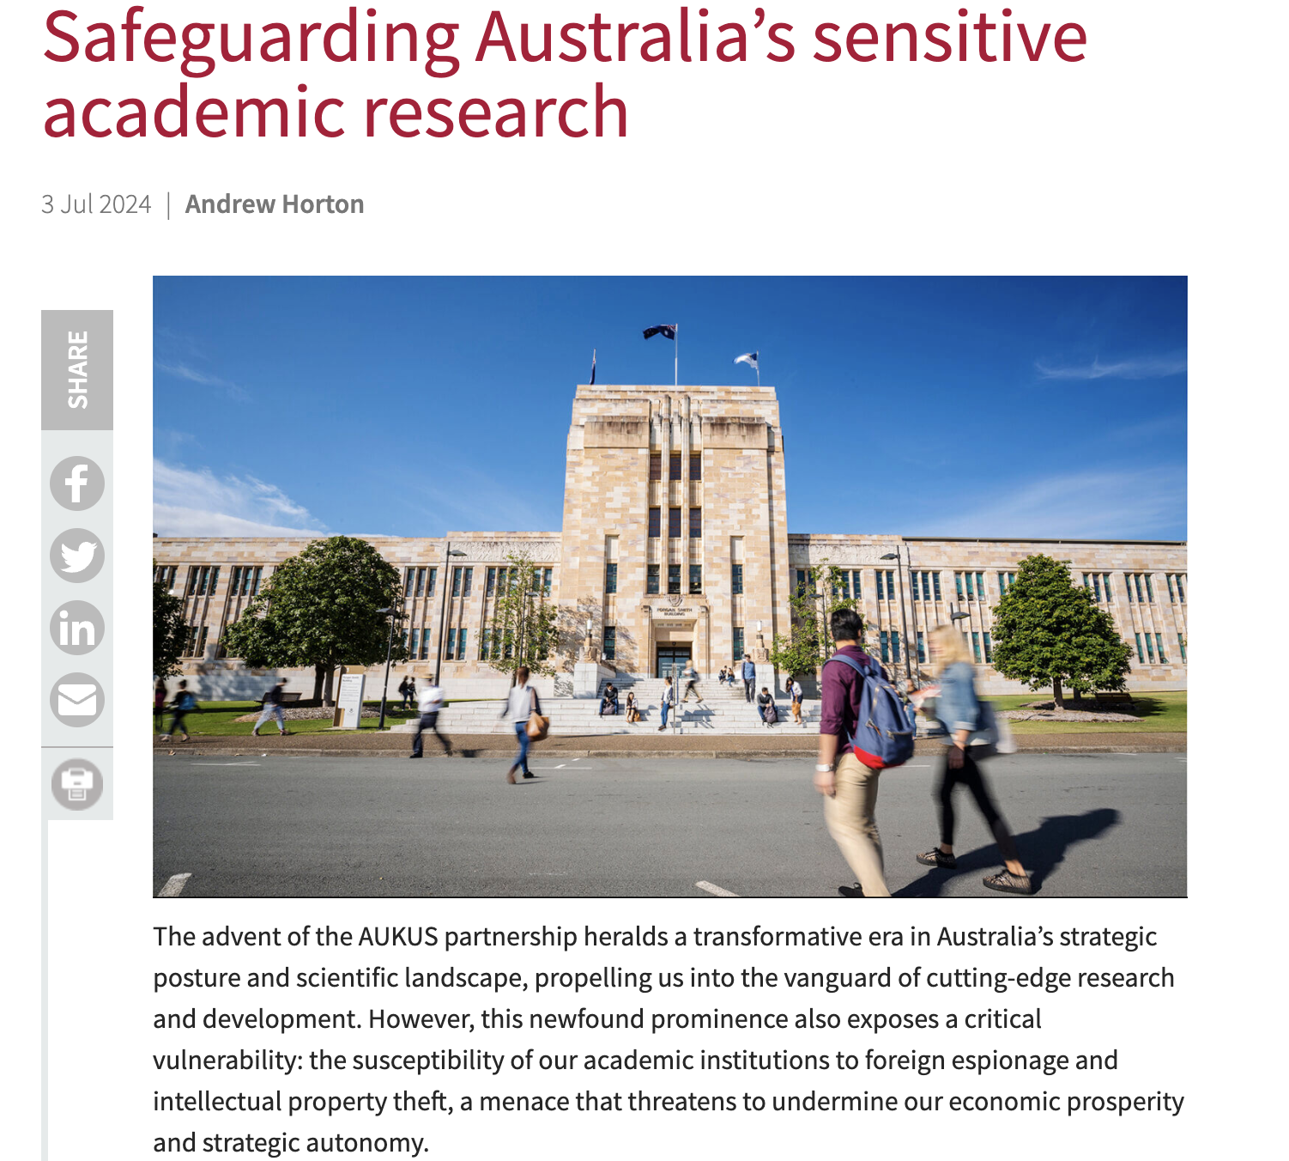
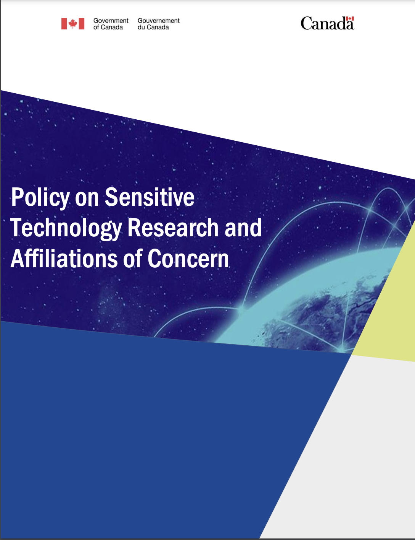
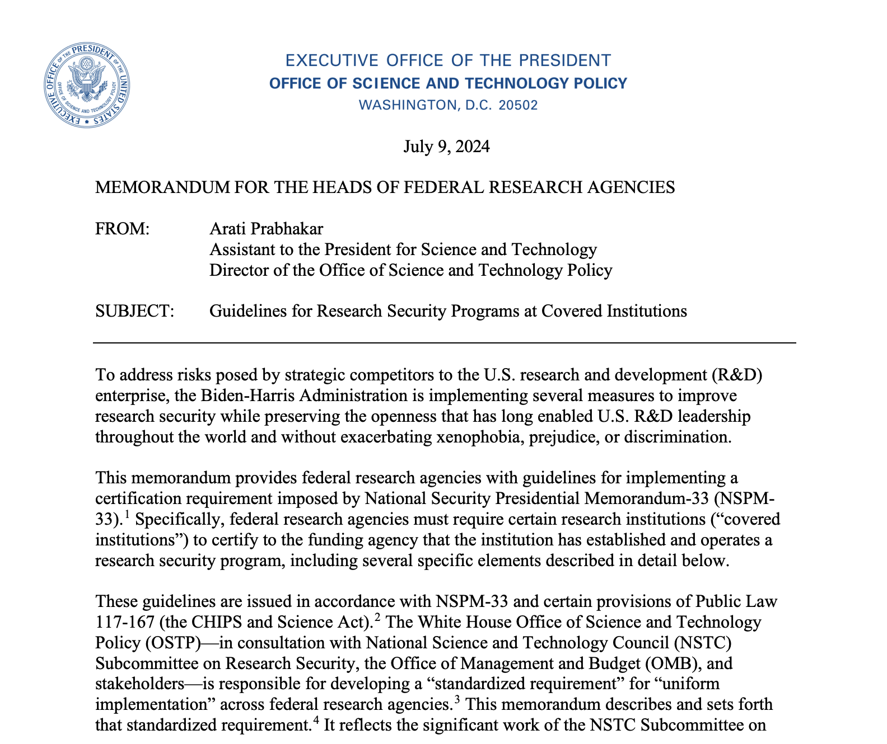
A rapidly developing space
Notes:
Research security is under increased scrutiny by governments and funders across the world. There are a host of mandatory and emerging research security requirements. Universities are increasingly taking proactive measures to assess institutional risks, verifying disclosures and reviewing researcher networks. But for many it’s a new and challenging landscape to navigate - it’s also rapidly changing.

Slide 4
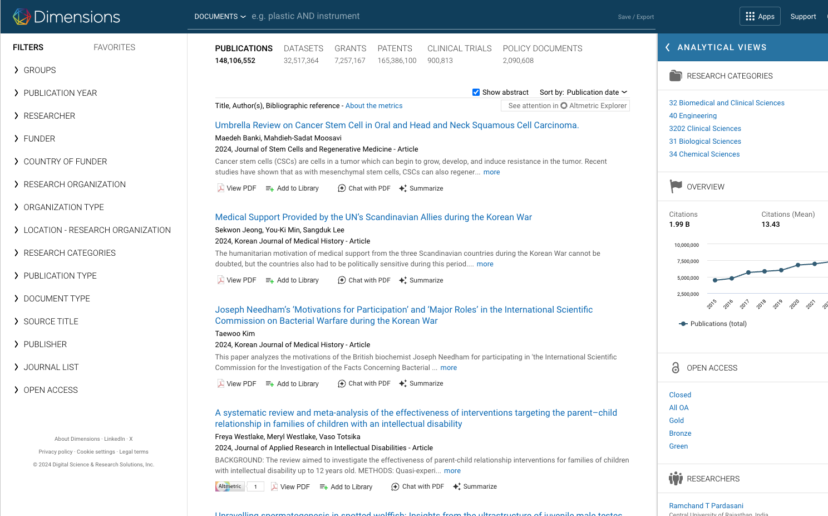
Dimensions - it’s better to be inclusive
It’s Dimensions’ mission to provide users with as much important and timely data as can be delivered, and to empower users with tools and resources that allow them to draw from this vast corpus in ways most suited to their specific needs.
Dimensions knows that having access to the largest set of data - not a narrow, exclusionary set - enables users to make the most informed decisions, and Dimensions believes that users are in the best position to determine what’s important for themself and their organization.
Notes:
The complexity of these issues combined with the vast networks of research activity globally means that institutions often can’t “go it alone.”
This is where we as a data and analytical solutions vendor come in. Dimensions is a linked research database with a mission to provide users with as much important and timely data as possible while also providing tools that empower users to make their own discoveries and analyst. When it comes to research security, it’s essential to have as much data as possible and Dimensions’ mission perfectly aligns with this. Dimensions has an inclusive approach, aiming to provide the largest set of data possible, not an exclusionary one. We believe users are in the best position to determine what’s important for themself and their organization, which is even more critical when we talk about research security.

Slide 5
Content and links in Dimensions
148m
Publications 108m full text index
2.8m links
899k
Clinical trials
607k links
22m links
2bn links
281m
Altmetric data
points
17m links
165m
Patents
40k links
641k to funders
3.8m links
3.1m links
25m links 39m to funders
510m links
290k links
384k to funders
2.1m
Policy documents
7.3m
Grants
$2.5 trillion in funding
32m
Datasets
1.3m links
2.1m to funders
Status: August 2024
Notes:
It’s worth noting that Dimensions Analytics (the web app for Dimensions) wasn’t created for research security. Dimensions data has wide applications across the university and for government, corporate, and publishing organizations. This is due to robust data across multiple content types: publications, datasets, grants, clinical trials, patents, policy documents.

Slide 6
Dimensions for research security
“Dimensions has become the cornerstone of our workflow to understand the extent of foreign influence at our institutions… Processes that took us hours to complete in the past can now be done in just minutes with much greater fidelity.” Chief Research Security Officer University System Office
Dimensions has worked closely with academic research security professionals since 2019.
The Research Security app was developed with an advisory group of research security users in response to an increasing demand for additional analytical capabilities unavailable in Dimensions Analytics.
Notes:
We started working with academic research security professionals in 2019 (we saw users in this space finding Dimensions data critical for their work) and it led to an advisory group of research security users that helped us in the development of the Dimensions Research Security app, which was created in response to an increasing demand for additional analytical capability unavailable in Dimensions Analytics.
With the Dimensions Research Security app, users can easily see and evaluate data associated with their institution in order to inform risk assessment. The app also provides enhanced researcher profiles that surface information like dual affiliations and published research cited in patents.

Slide 7
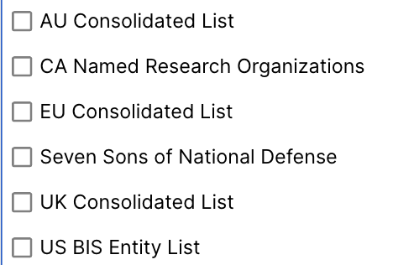
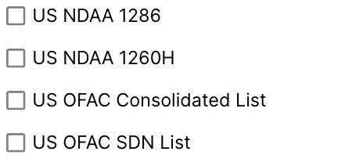
Filters
We supply numerous filters in the app so that you can limit analyses and results according to your needs. You make the calls on what’s important to you.
Time parameters
Flagged country/territory
Flagged funder country/territory
Flagged research organization
Flagged organization lists
Fields of Research
Notes:
The app enables users to drill down via various filters to look at collaborations that require disclosure and/or may be considered ‘high risk’. An example is filtering by flagged organization lists.

Slide 8
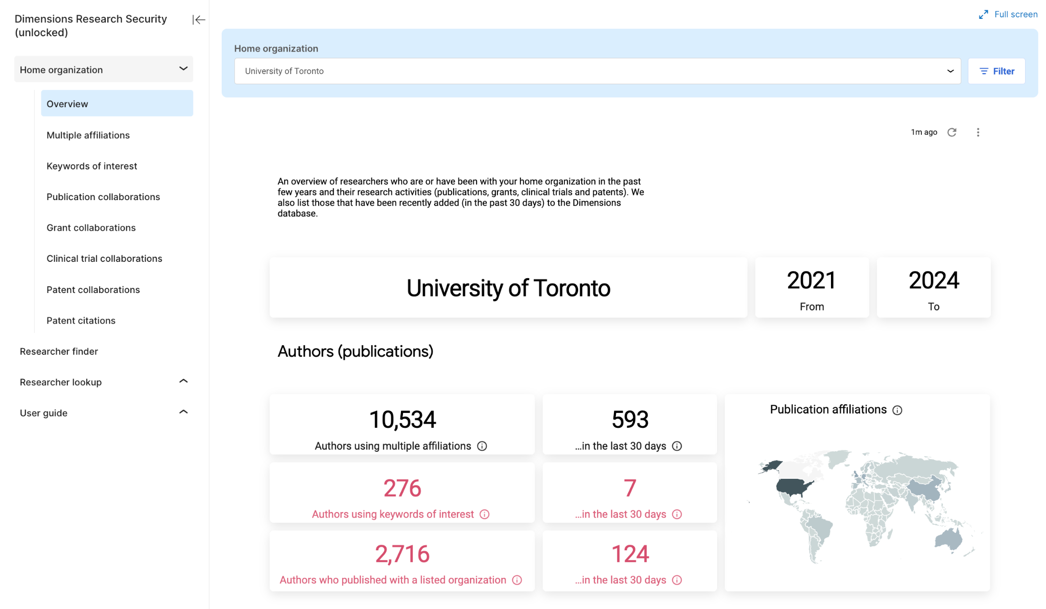
Notes:
The application is broken up into two sections. The intent of the Home organization section is to help surface potential areas of interest for research security on an organizational level.
This includes insight into authors publishing with multiple affiliations, publications with co-authors from the home organization that mention ‘keywords of interest’ related to talent recruitment programs, and analyses of international collaborations.

Slide 9
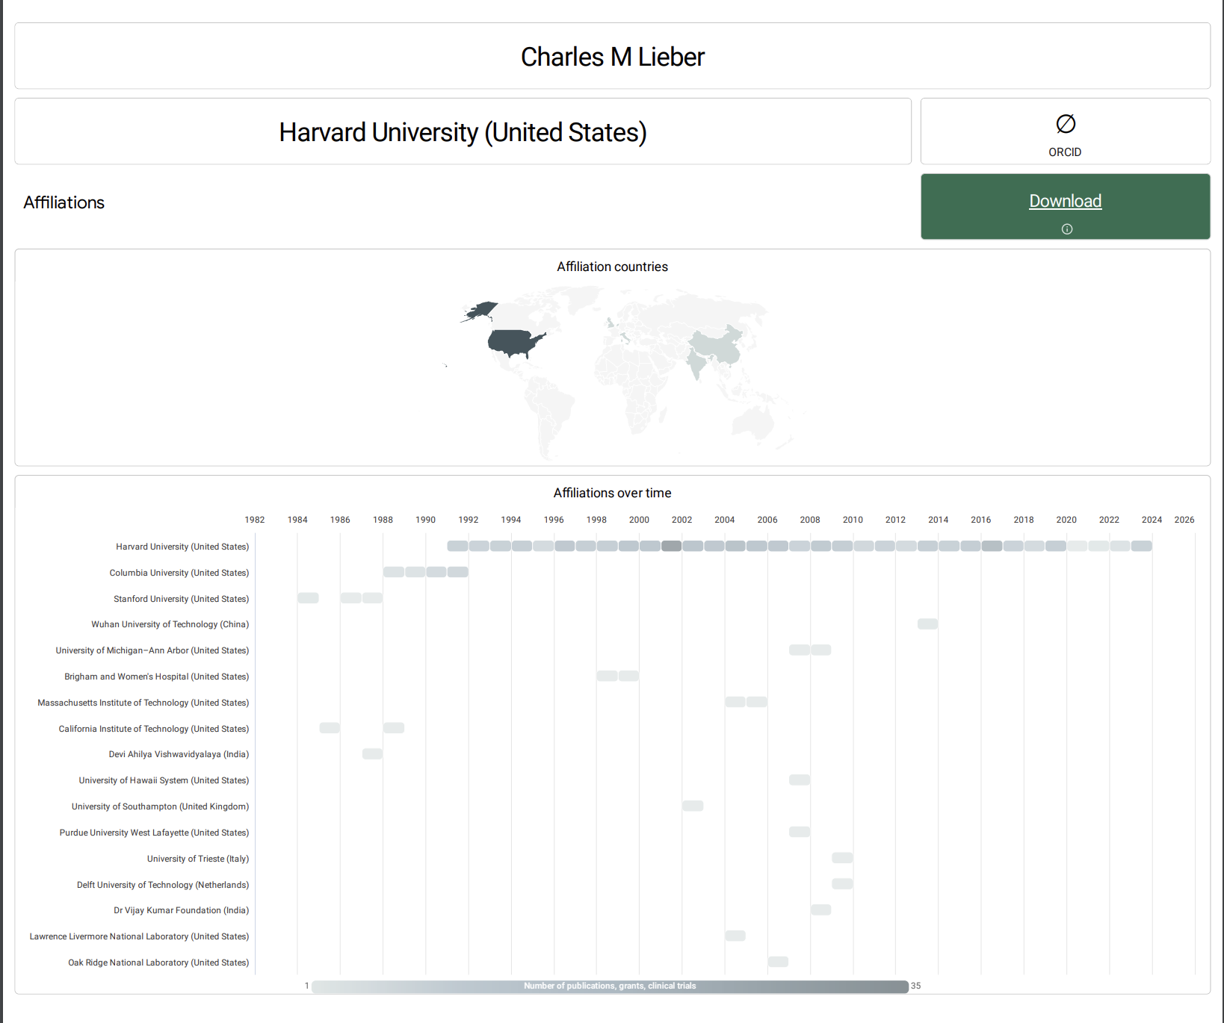
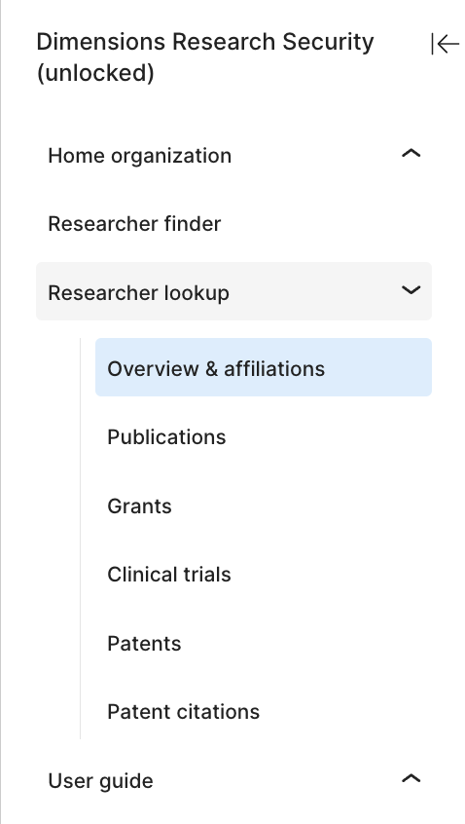
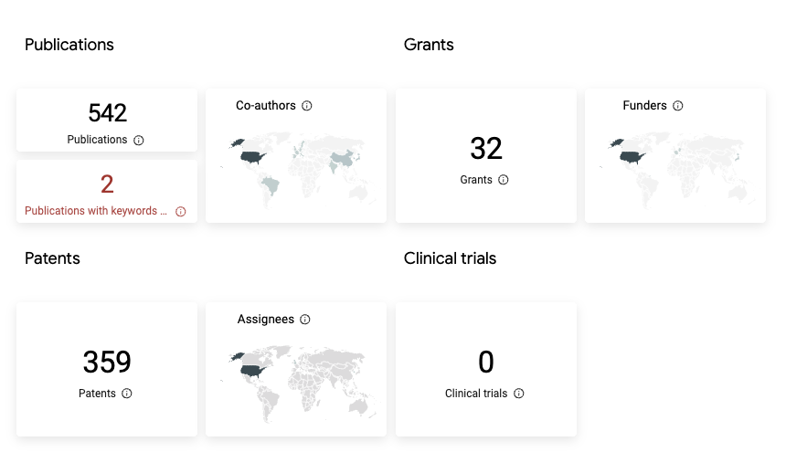
Notes:
The intent of the Researcher look-up section is to provide enhanced information on the researchers in Dimensions. This includes affiliations used over time, collaborations past and present, and researcher publications and funding.

Slide 10
Meeting the needs of the community
THE NEED
Assessing and prioritizing potential risk to make the most efficient use of your available resources
Assess & prioritize risk
Comply with mandates
Comprehensively vet researchers
THE NEED
Comprehensive data to inform disclosures and certifications
THE NEED
Vetting potential researchers on sensitive research projects
Notes:
Like the landscape of research security, it’s a rapidly developing space and open communication with the research security community is essential. As a vendor, we recognize the responsibility we hold in developing a tool in the sensitive and high stakes space that is research security. We aren’t here to tell users what to do but empower them with the largest set of data possible and a tool that is time saving and easy to use so that they can make the decisions they feel will best protect and safeguard the research at their organization.

